Slide 1
Web Interactions Https - Html - Javascript
arnaud.nauwynck@gmail.com

Slide 2
Outline
Https → Load Html + Js + Css + Json + *
Js → Call Http : SPA, Rest + Json
Html → execute Js <script>
Html → trigger events to Js
Js → Query/Update Html DOM
Custom Elements, Shadow DOM, Frameworks

Slide 3
Interactions
Html (DOM)
Https
JavaScript

Slide 4
Outline
Https → Load Html + Js + Css + Json + *
Js → Call Http : SPA, Rest + Json
Html → execute Js <script>
Html → trigger events to Js
Js → Query/Update Html DOM
Custom Elements, Shadow DOM, Frameworks

Slide 5



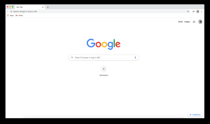
Web Browser = Http Client Web Site = Http Server
Http Server
DNS hostname: www.google.com
Port : 8443
Protocol: Http + TLS
Resource path: some-path
Url: https://www.google.com:8443/some-path
Your PC
mydesktop.home
192.168.0.1
http Request
http Response

Slide 6
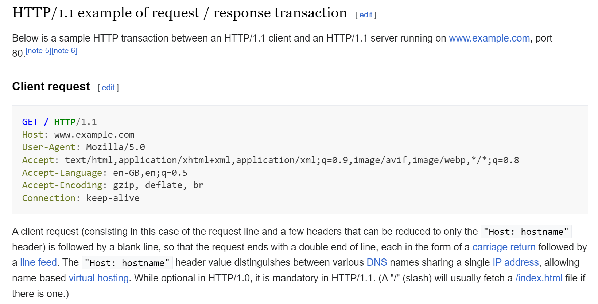
Http Request (GET, POST, PUT, ..)
https://en.wikipedia.org/wiki/HTTP

Slide 7
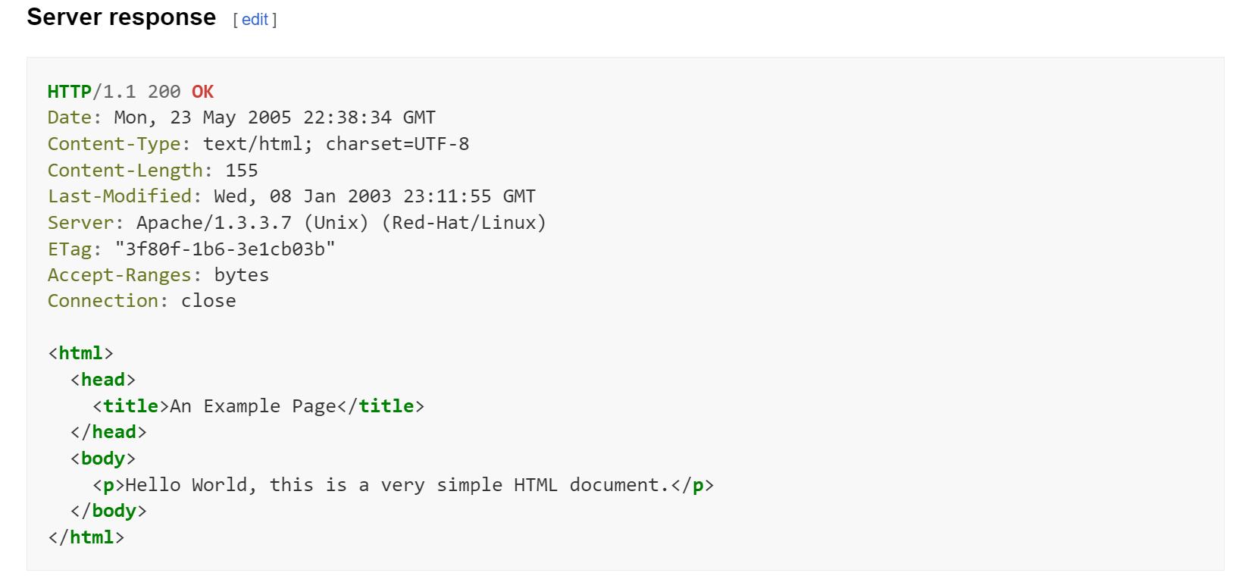
Http Response (200, 300, 400, 500 ...)
https://en.wikipedia.org/wiki/HTTP

Slide 8
Step (after TCP Connect + SSL Handshake) client write http Request text
Client WRITE request text, then flush socket buffer
Line1 = « GET /path/foo?bar HTTP/1.1 »
Line 2,3…N= http headers:
« key1 : value1 »
« key2 : value2 » « keyN : valueN »
Empty Line: « »
Then : body… N bytes
« binary-content, maybe ascii html, json, image, … »

Slide 9
Request = VERB, Path, Headers, Body
Client WRITE request text, then flush socket buffer
Line1 = « GET /path/foo?bar HTTP/1.1 »
Line 2,3…N= http headers:
« key1 : value1 »
« key2 : value2 » « keyN : valueN »
Empty Line: « »
Then : body… N bytes
« binary-content, maybe ascii html, json, image, … »
GET, PUT, POST, DELETE,HEAD,PATCH,…
are http « Method Verbs »
request Path (and query parameters)
are relative to server host
http Request Headers some are standards headers: Host, Content-Type, Accept, ..
http Request Body optional (generally none in GET and DELETE,
one in PUT and POST)

Slide 10
Client WAIT response, and do not write any more to socket
possible strategies:
1/ negotiate in http Header to keep socket open, and re-use
2/ half-close the socket on client-side (socket is now read-only)

Slide 11
server write http Response
Server WRITE response text,
then flush socket buffer
Line1 = « HTTP/1.1 200 OK»
Line 2,3…N= http headers:
« key1 : value1 »
« key2 : value2 » « keyN : valueN »
Empty Line: « »
Then : body… N bytes
« binary-content, maybe ascii html, json, image, … »

Slide 12
Response = status, message, Headers, Body
Server WRITE response text,
then flush socket buffer
Line1 = « HTTP/1.1 200 OK»
Line 2,3…N= http headers:
« key1 : value1 »
« key2 : value2 » « keyN : valueN »
Empty Line: « »
Then : body… N bytes
« binary-content, maybe ascii html, json, image, … »
200,300,301,400,404,500,…
are http « status code»
« status message»
http Response Headers some are standards headers: Content-Type, ..
http Response Body

Slide 13
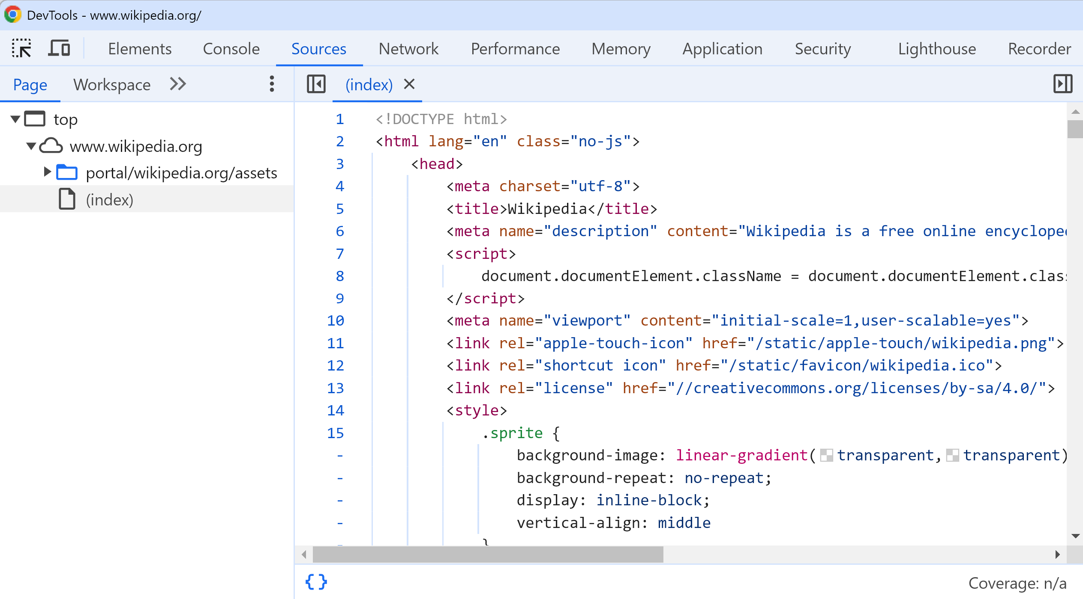
Loaded Source Html Page
example: https://www.wikipedia.org/

Slide 14
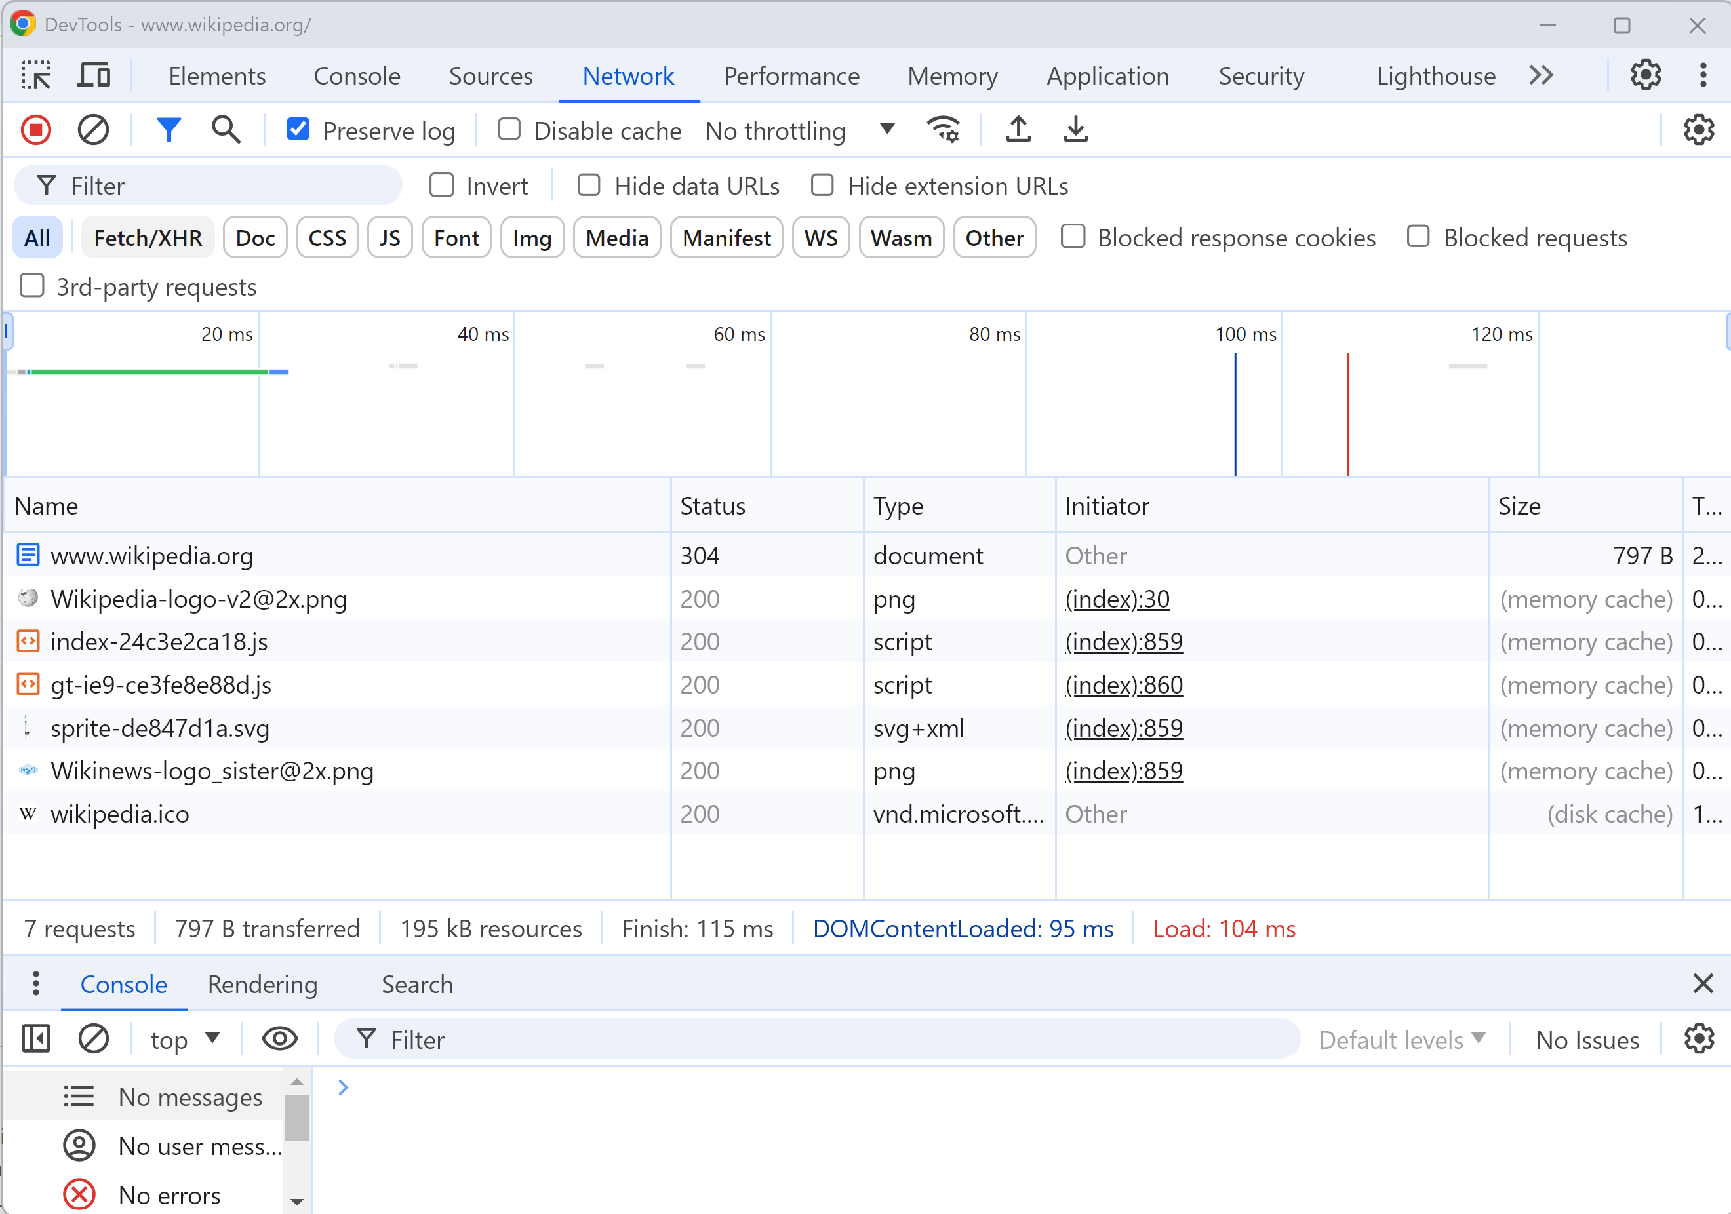
loading a page = N Requests: html, png, js, svg, css..
example:
https://www.wikipedia.org/

Slide 15
How to GET/POST Binary Content ?
Http Requests/Responses have header+body parts:
part 1 in text:
line 1 = VERB (GET/PUT/POST..) + path
line 2, 3, ..N = http header name=value
Requests headers include
"Accept="
"Compression = ..", "Connection = keep-alive"
Responses headers include
"Content-Type="
"Content-Length= <length>"
separator line : "" (empty)
part 2 in any format (byte[])

Slide 16
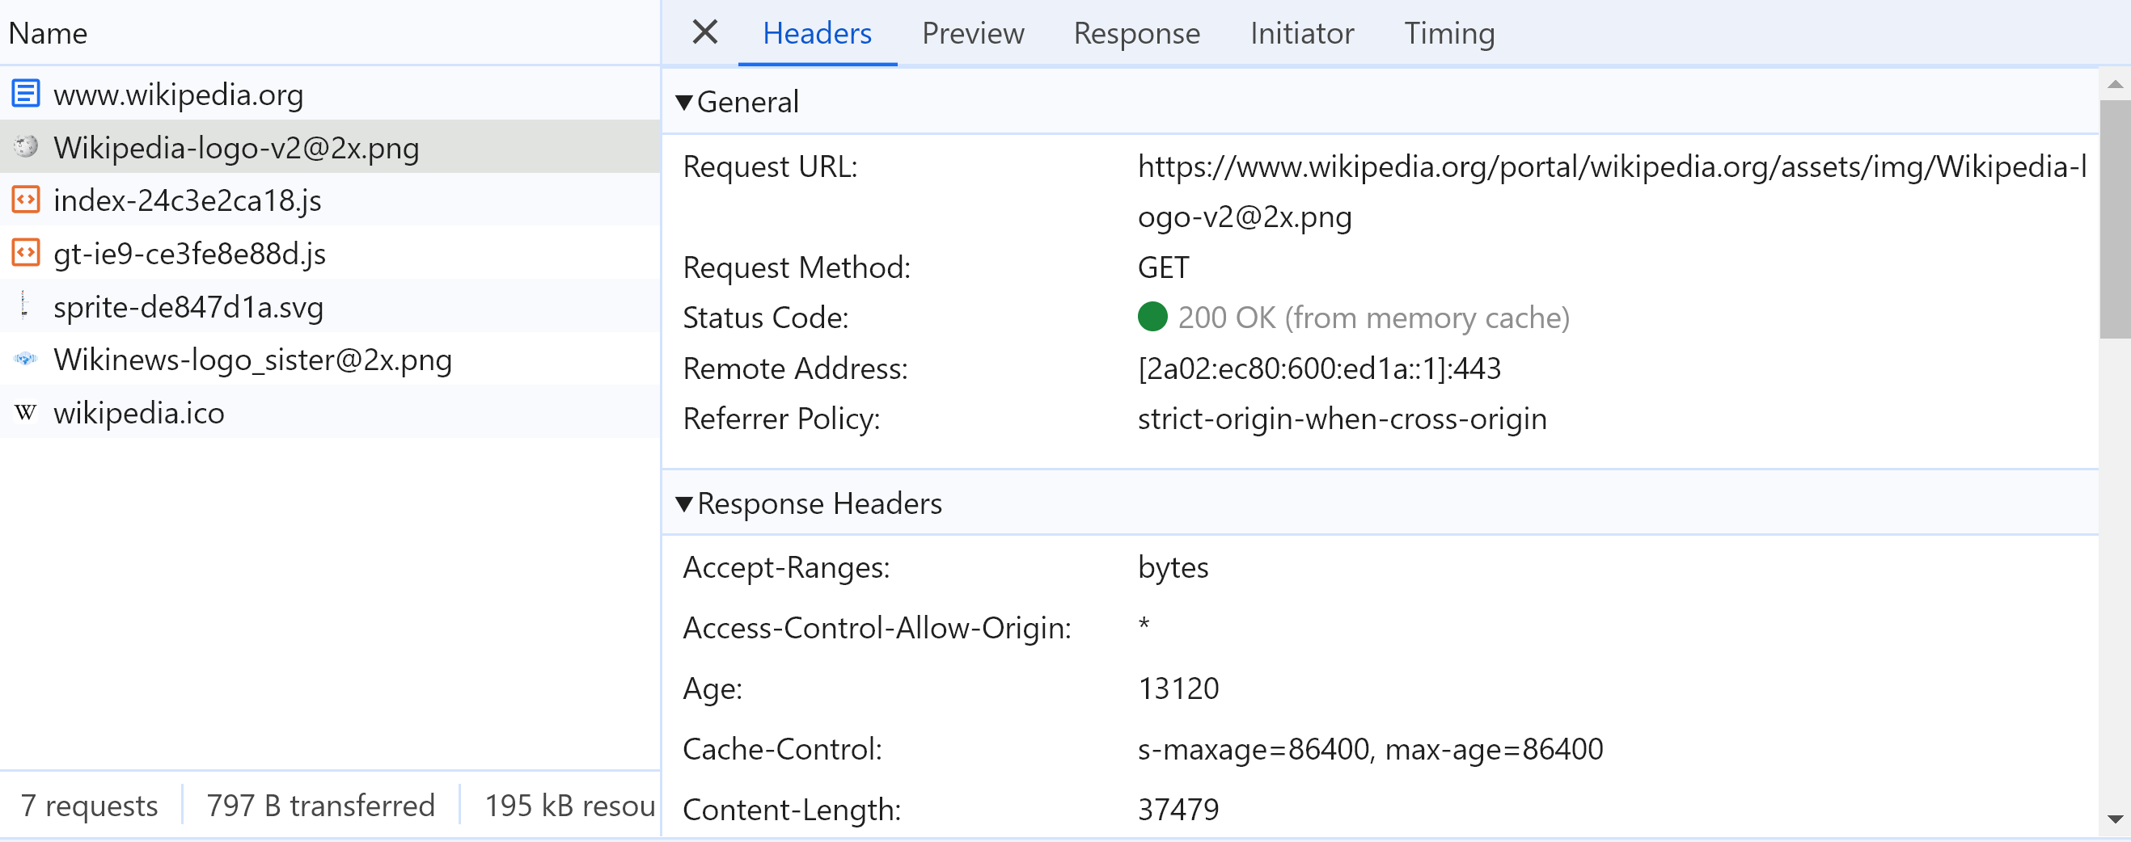
Content-Length
How can Http knows the full binary content response, then close the socket ?
... By using a Http Header "Content-Length"

Slide 17
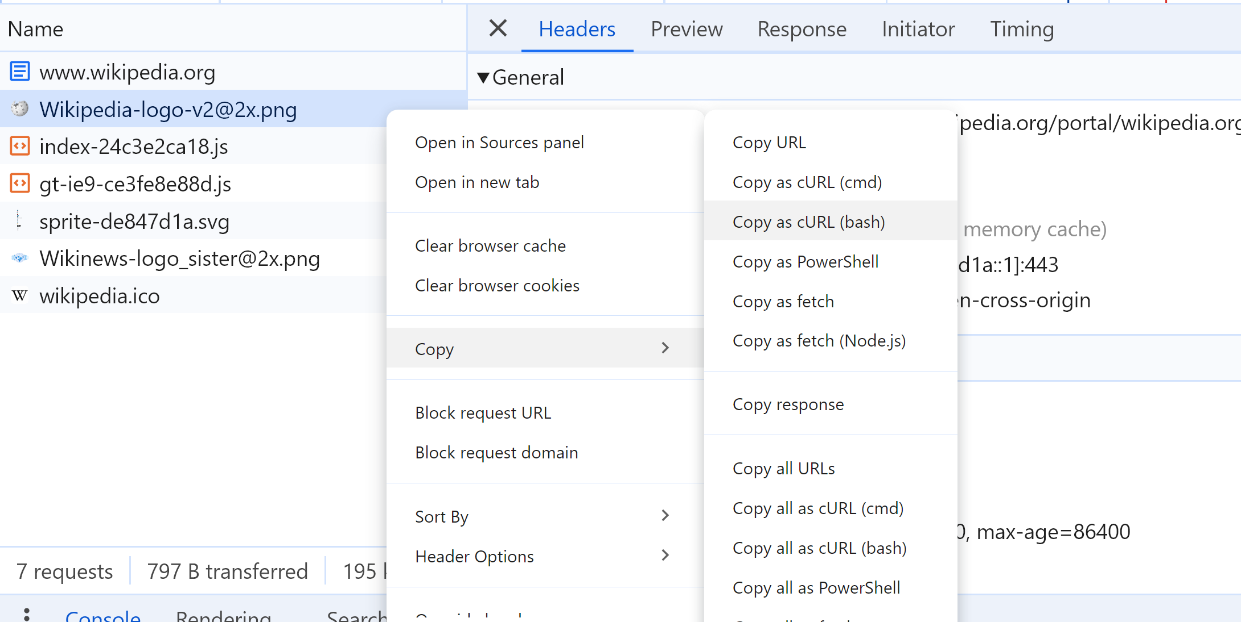
Debug with Curl
to reproduce Http request manually from "Curl"

Slide 18
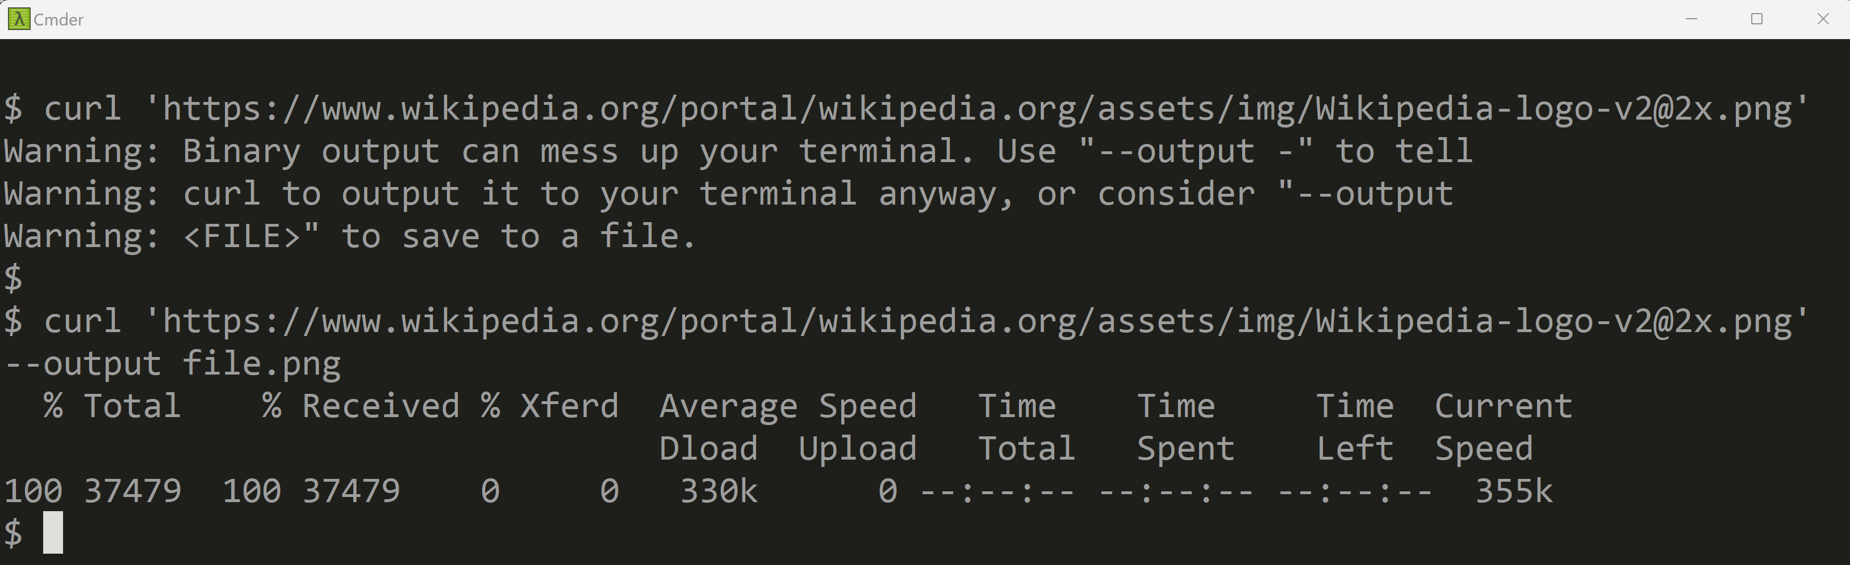
Curl

Slide 19
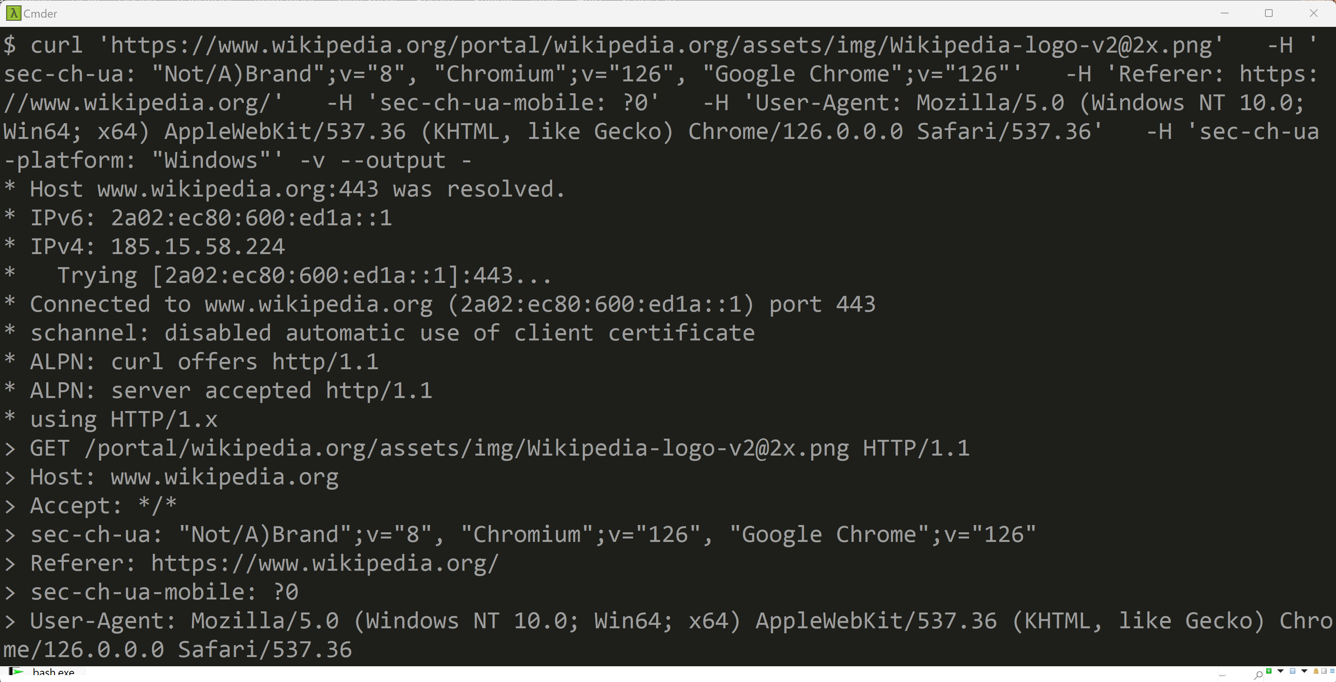
Curl -v part 1/3: connection "*" + sent ">" Http headers
connection
sent
http headers

Slide 20
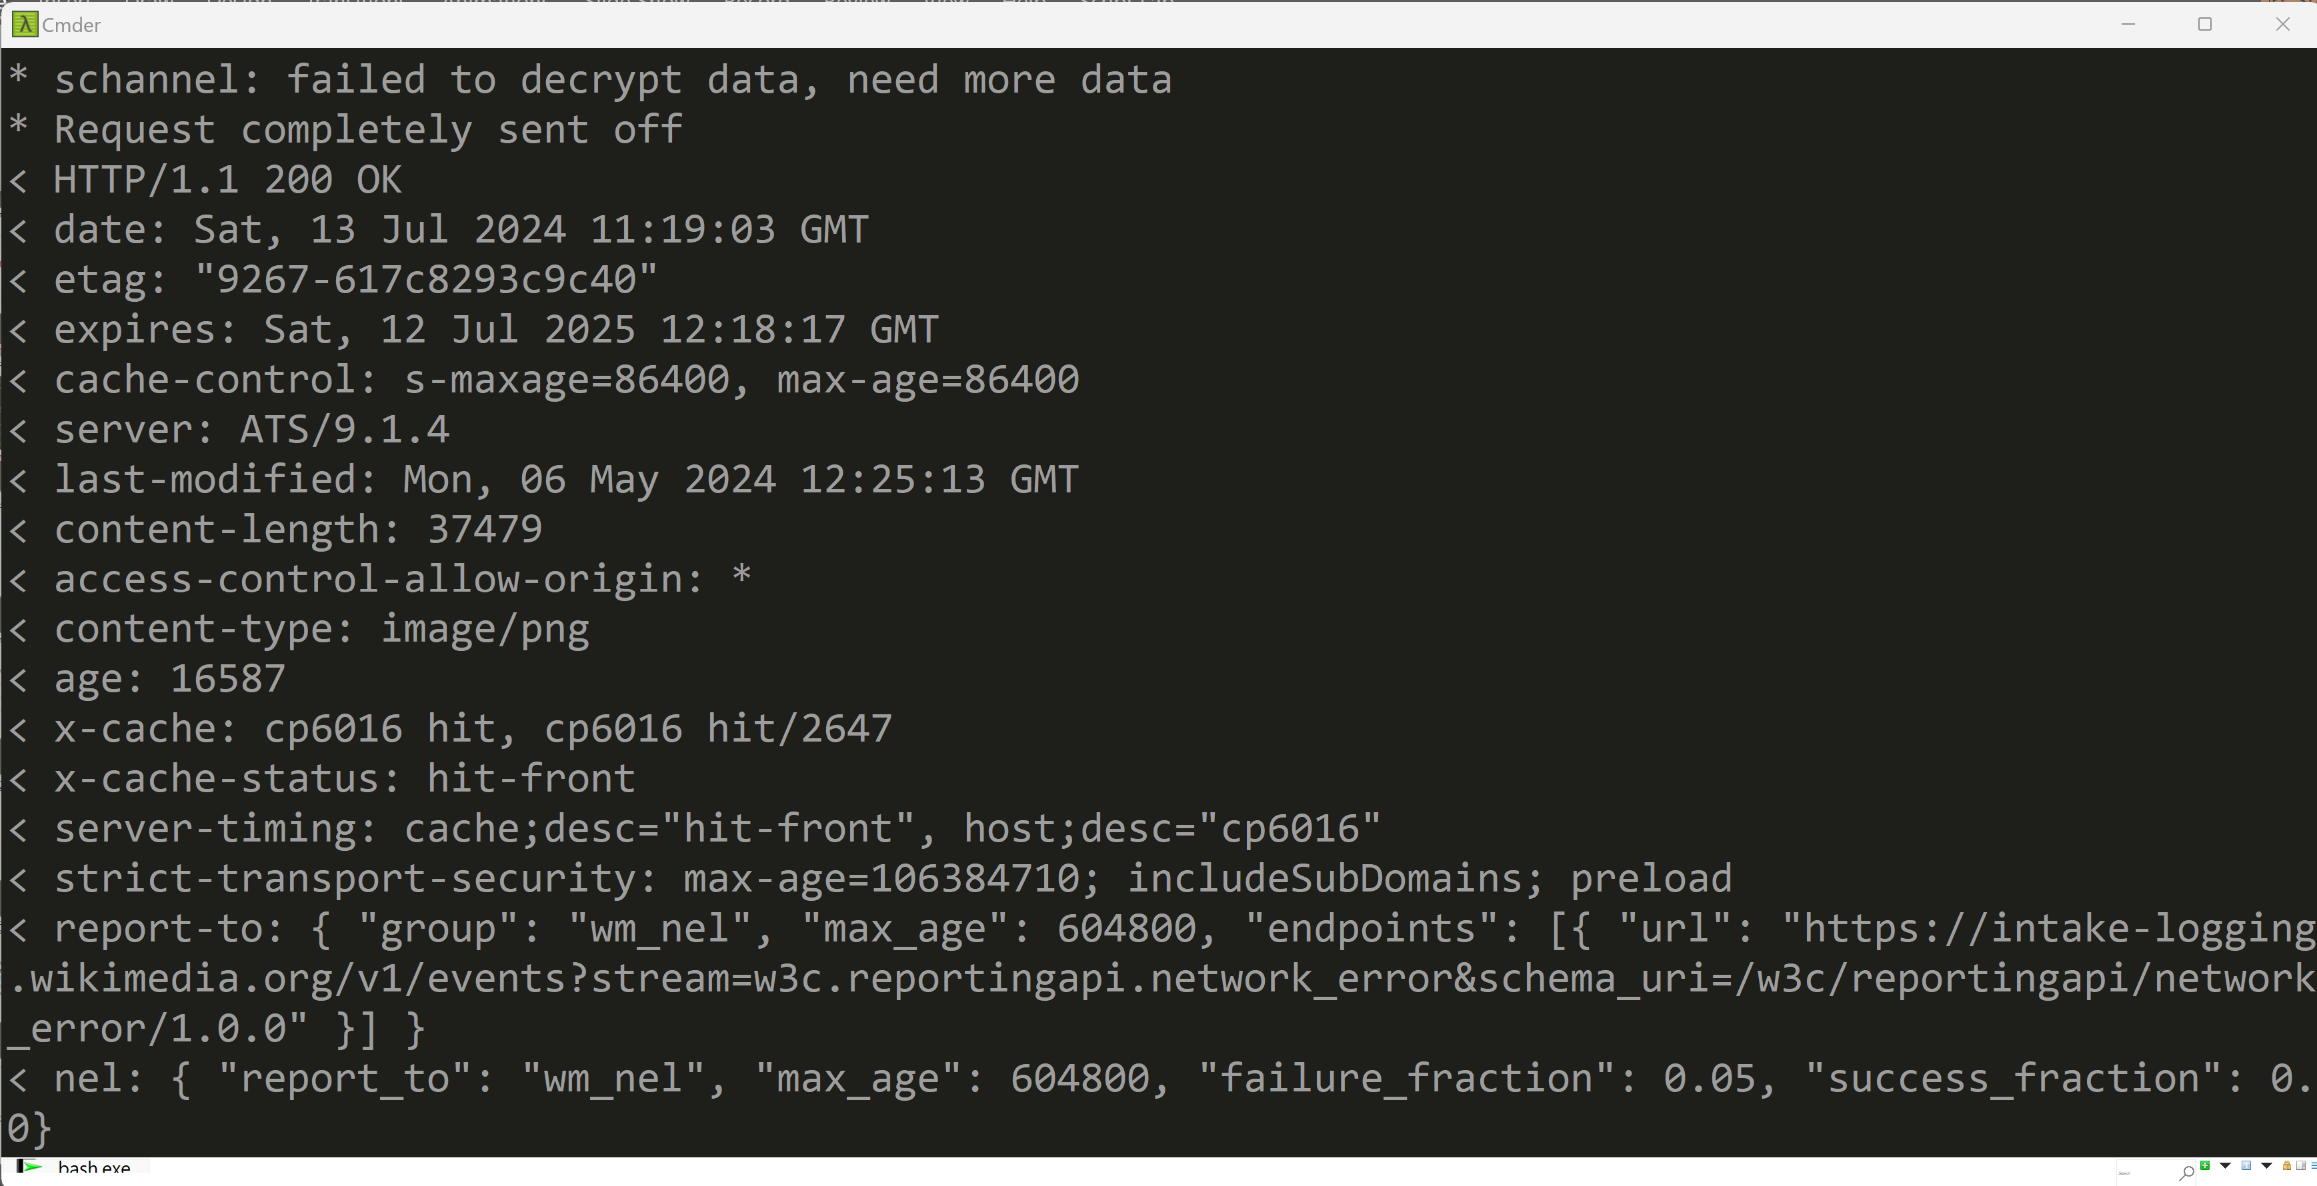
Curl -v part 2/3: "<" received http headers
received
http headers

Slide 21
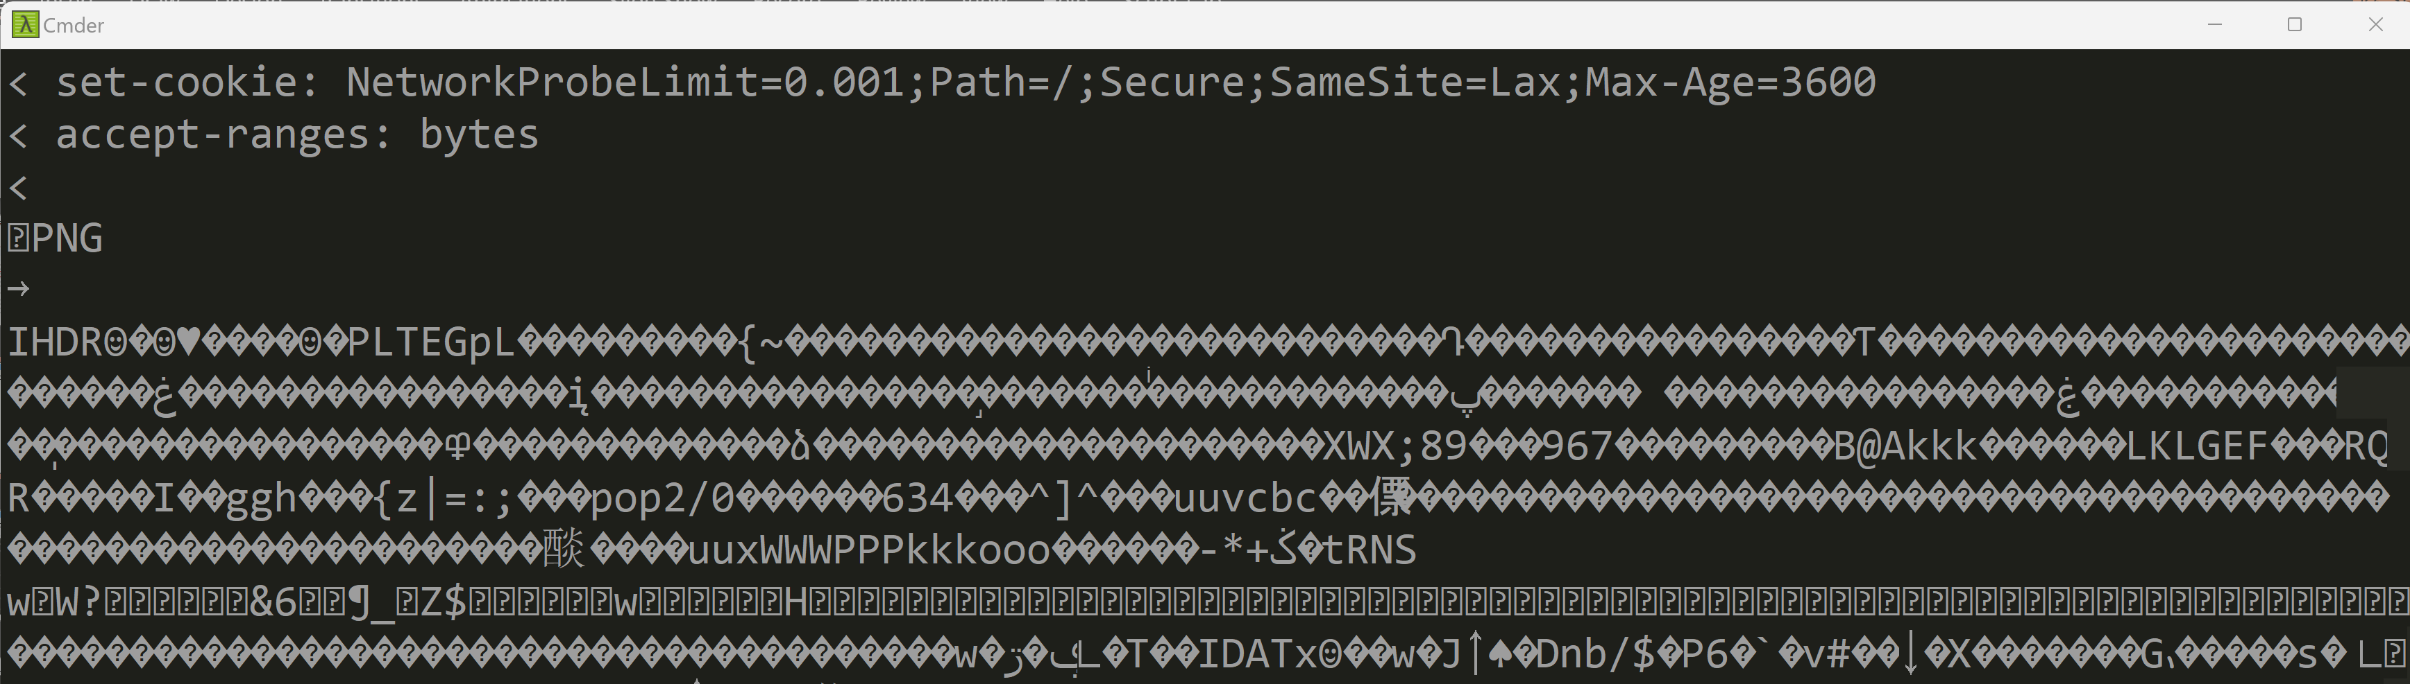
Curl -v part 3/3: received body
empty line
separator
received
body
(binary)

Slide 22
Summary Interaction: Browser URL -> Http -> Loaded Resources
(1) enter http URL
(2) connect
http GET request
Html (DOM)
(3) Html response
Https
(4) parse HTML
(5) extract
<img>
<style>
<script>
(6A) case <script href="app.js"/>
JavaScript
(6B) case
<script> code </script>

Slide 23
Outline
Https → Load Html + Js + Css + Json + *
Js → Call Http : SPA, Rest + Json
Html → execute Js <script>
Html → trigger events to Js
Js → Query/Update Html DOM
Custom Elements, Shadow DOM, Frameworks

Slide 24
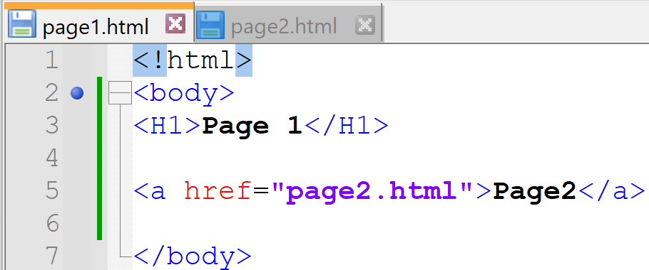
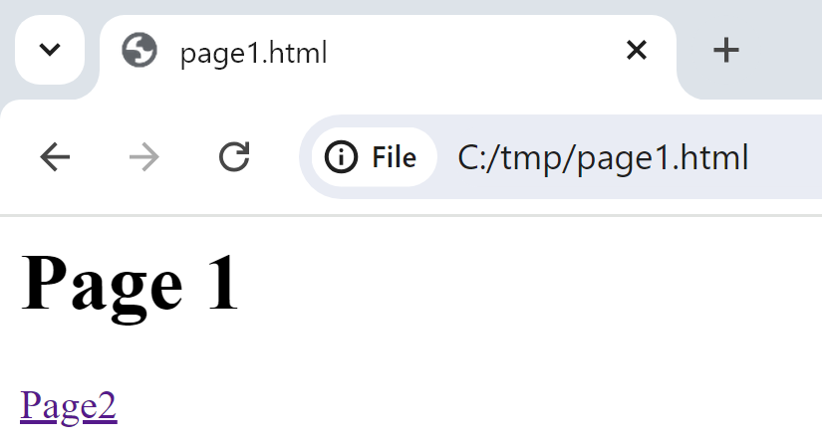
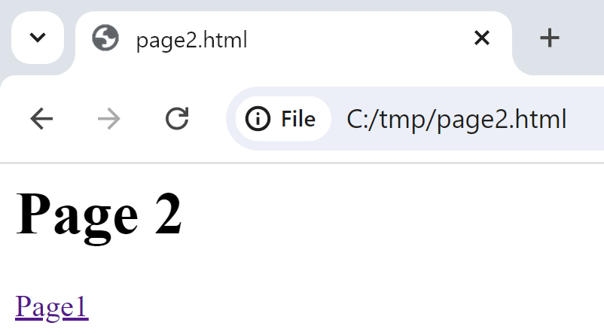
Old Ways to Change Pages 1/ change page with <a href="page.html">

Slide 25




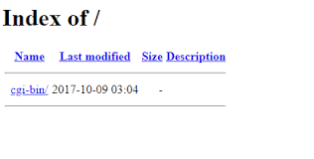





Old Ways to Change Refreshed Pages 2/ server-side generate pages
/htdocs / cgi-bin / *.sh
*.SP

Slide 26


Java Servlet & Jsp (html in java / java in pseudo-html )
= plain old java code printing « html » text
void toHtml(ServletOutputStream out) {
if (cond) {
out.print("<div> <span \"attr\"=\"v1\"> ..");
} else {
out.print("<div> <span \"attr\"=\"v2\"> ..");
}
out.print( new Date() );
}
= pseudo html/xml/markup code containing java
<% if (cond) { %>
<div><span "attr"="v1"> .. </span></div>
<% } else { %>
<div><span "attr"="v1"> .. </span></div>
<% } %>
<%= new Date() %>

Slide 27
Click <href> … RE-Loading new html page
Web Browser
/Page1.html
http GET /page1.html
<script>app1.js</script>
Free old page memory
http GET /page1.js
app1.js
Parse js
+ execute function init() {.. }
+ parse css + render html
http GET /page1.css
http GET /page1-image2.png
Dynamic Server Pages Server
CLICK on <href url=« /page2 »></href>
http GET /page2
/Page2
http GET /page2.js (or shared cached)
(re)Parse js
+ RE execute function init() {.. }
+ (re)parse css + RE render html
REPLACE page
with
new page
http GET /page2.css (or shared cached)
http GET /page2-image2.png (or shared cache)

Slide 28
Not only a Developper problem… Html+Js+CSS re-Rendering slowness + Network + .. for reloading pages links
SLOW … SLOW ….
NETWORK Bandwidth CONSUMING
+ Network Latency
+ CPU CONSUMING

Slide 29
Solution to Multiple Pages Application Problems ? caching + optims + workarounds … ? => SPA = Single Page Application !!

Slide 30
SPA = Single Page Application … still dynamic, still Multiple Rest Json requests
Web Browser
/Page1.html
http GET /page1.html
<script>app1.js</script>
http GET /page1.js
app1.js
Parse js
+ execute function init() {.. }
+ parse css + render html
http GET /page1.css
http GET /page1-image2.png
Web Server
CLICK on <button (click)=« callFunction() » >
http POST /api/restEndpoint1 {json}
REPLACE add/remote/update some <div>
Within SAME page
response {json}
http POST /api/restEndpoint2 {json}
response {json}

Slide 31
http API Server (cf Rest Api)
Terminology: Http Api Server
http request GET/POST/PUT/DELETE
On resource /{dynamicEntityPath}/{id}?{query}
Request body {json}
http Api Client
Http Api Server
response body {json}
Mostly *.json
Maybe also few (static) pages *.html,*.js,*.css

Slide 32
How to Code High-Level Http Request in JavaScript ?
Spoiler Alert: using non-blocking Async IO
... more complex than regular system calls on Socket

Slide 33
Request as "Blocking" (Low-Level) Code / SystemCalls
Code (ex: java)
System Calls
Socket s = // new Socket(...)
SSLSocketFactory.getDefault().createSocket(..)
s.connect(...)
OutputStream out = s.outputStream()
out.write("GET / HTTP 1.0\n")
out.flush()
InputStream in = s.inputStream()
byte[] buffer = new byte[4096]
int readCount = in.read(buffer)
s.close()
connect()
write()
flush()
all blocking calls
( thread/process
suspended to wait )
read()
close()

Slide 34
In the Browser (Javascript Web Spec) ... only 1 "event loop" main Thread
JavaScript API from the Web Browser
implement ONLY
High-Level
NON-Blocking calls
(with Callbacks or Promises)

Slide 35
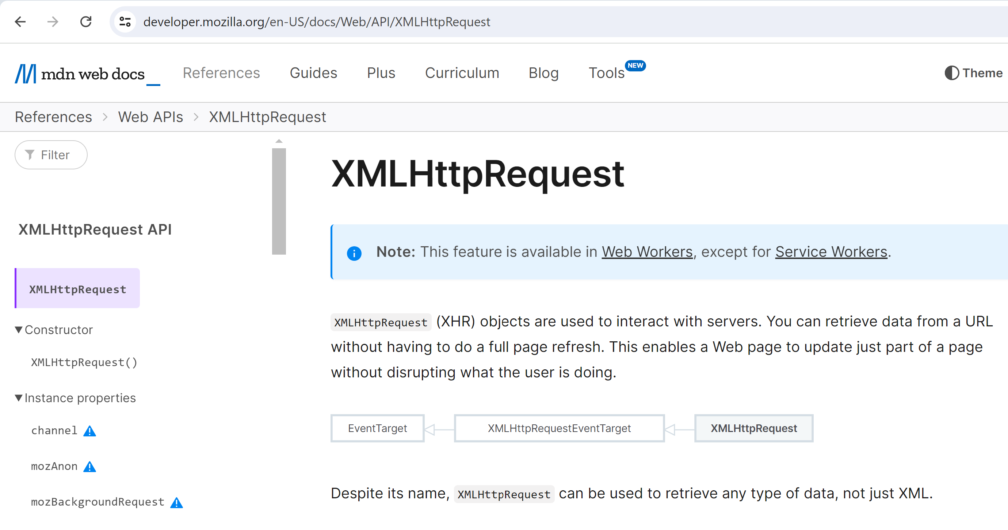
XML(?) HttpRequest

Slide 36
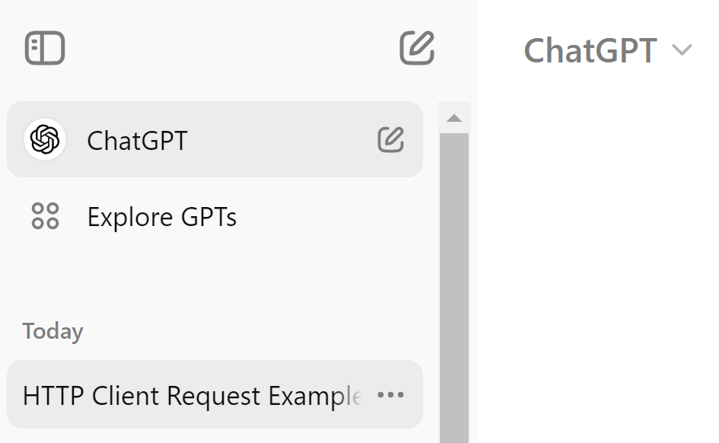

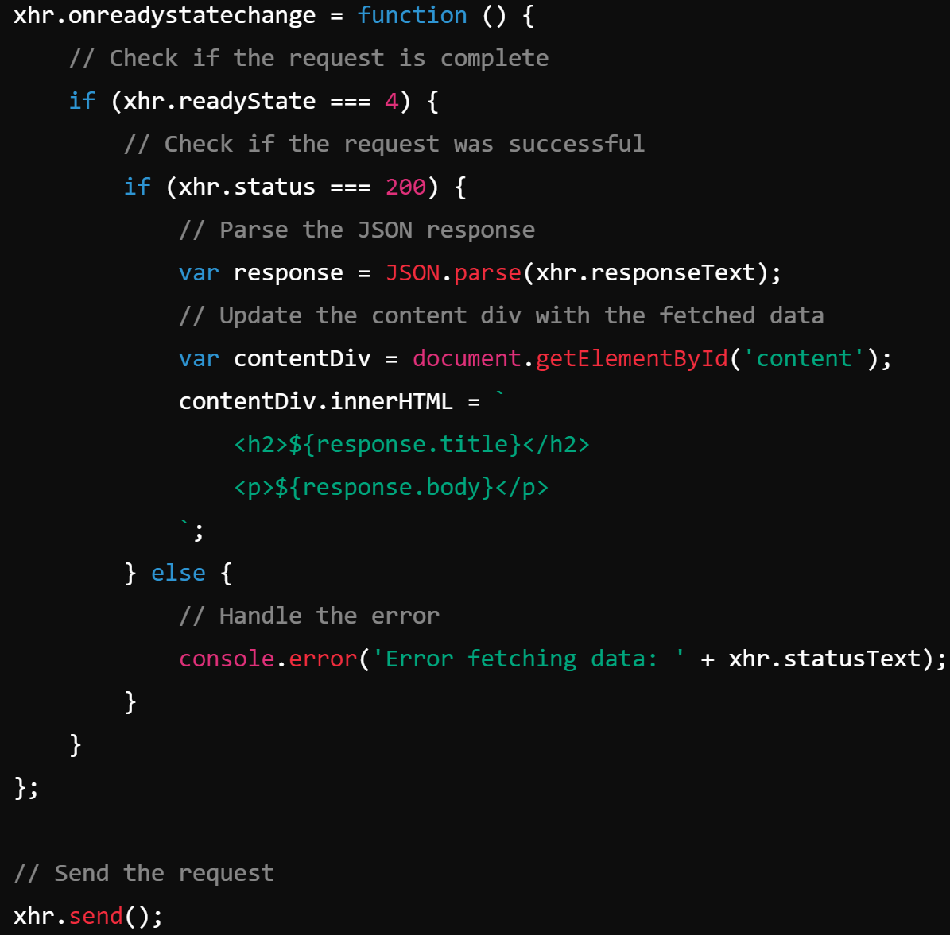
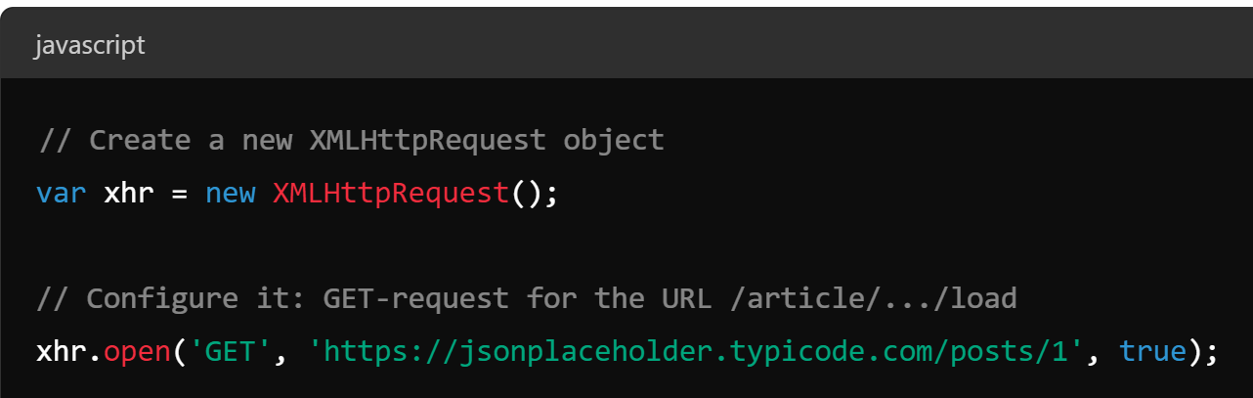
Sample Code

Slide 37
Callback Principles for Async
function asyncFunc( input, resultCallback ) {
...
}
yourApp() {
asyncFunc(..., resultCallback ); // <= return immediatly,
// and will call later: resultCallback( ...someResult )
... // next... called before resultCallback
}
function resultCallback( res ) {
...
}

Slide 38
Promises for Async
function asyncFunc( input ) { // return Promise
...
}
yourApp() {
var promise = asyncFunc(...); // <= return immediatly, will put result in promise later
promise.then(resultCallback);
promise.catch(errorCallback);
... // next... called before resultCallback
}
function resultCallback( res ) { ... }
function errorCallback( res ) { ... }

Slide 39
Equivalent "Cascaded Functional" Code
yourApp() {
asyncFunc(...) // <= return immediatly, will put result in promise later
.then( res => { // inlined lambda
...
} )
.catch( error => { // inlined lambda, when failure
...
} );
... // next... called before lambda
}

Slide 40
Equivalent Code using Angular RxJs Observable (deprecated: using 2 callbacks)
yourApp() {
asyncFunc(...) // <= return immediatly, will put result in promise later
.subscribe( res => { // inlined lambda
...
} , error => { // inlined lambda, when failure
...
} );
... // next... called before lambda
}

Slide 41
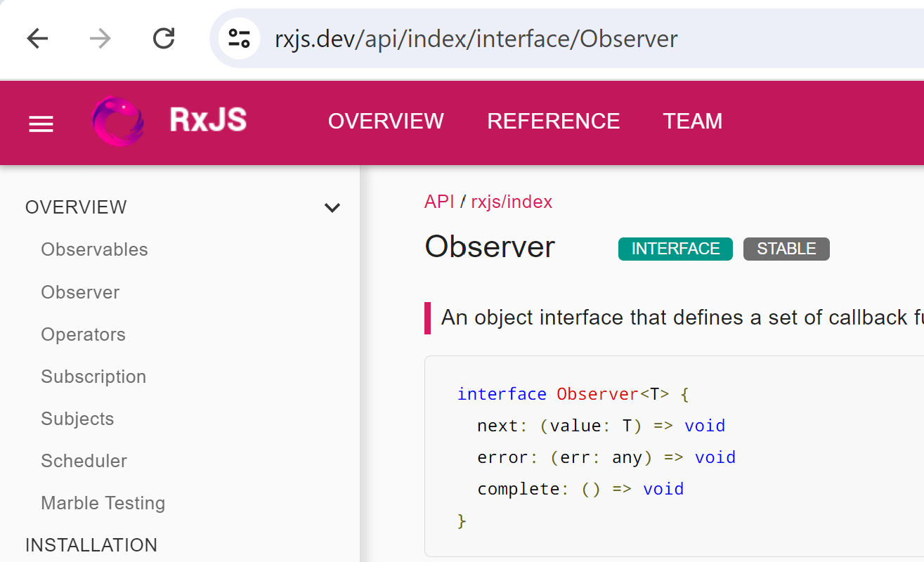
Equivalent Code using Angular RxJs Observable (1 object with 2 callbacks)
yourApp() {
asyncFunc(...) // <= return immediatly, will put result in observable later
.subscribe( {
next: res => { .. }, // inlined lambda
error: error => {.. } // inlined lambda, when failure
} );
... // next... called before lambda
}

Slide 42
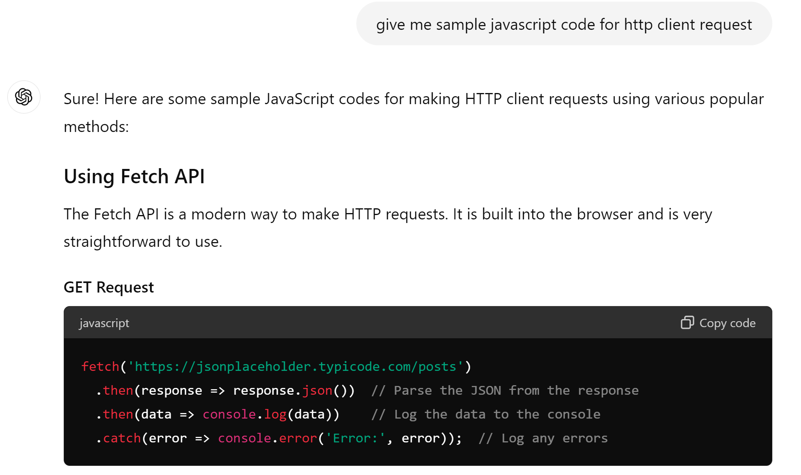
Http Request as Async (=Non-Blocking) Code

Slide 43
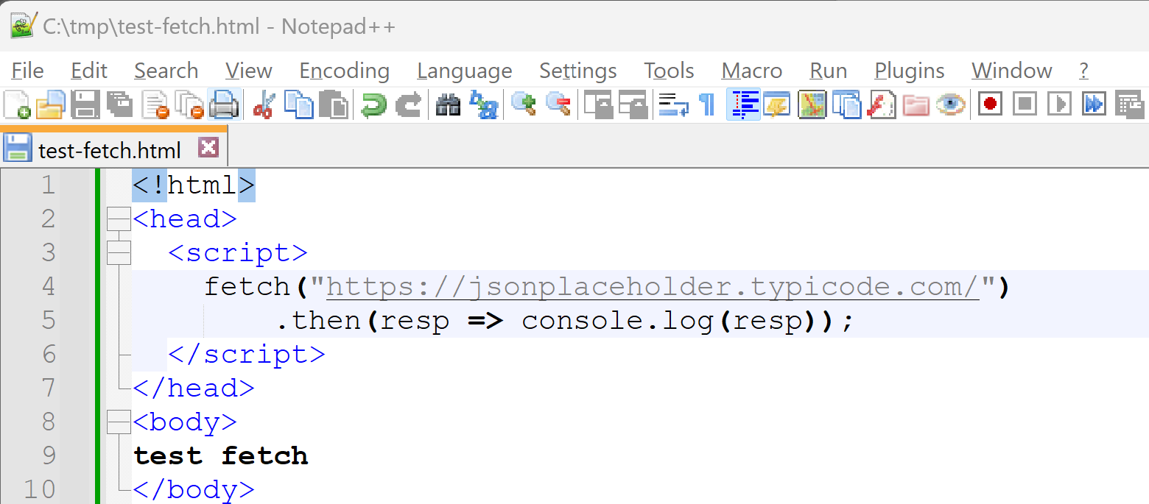
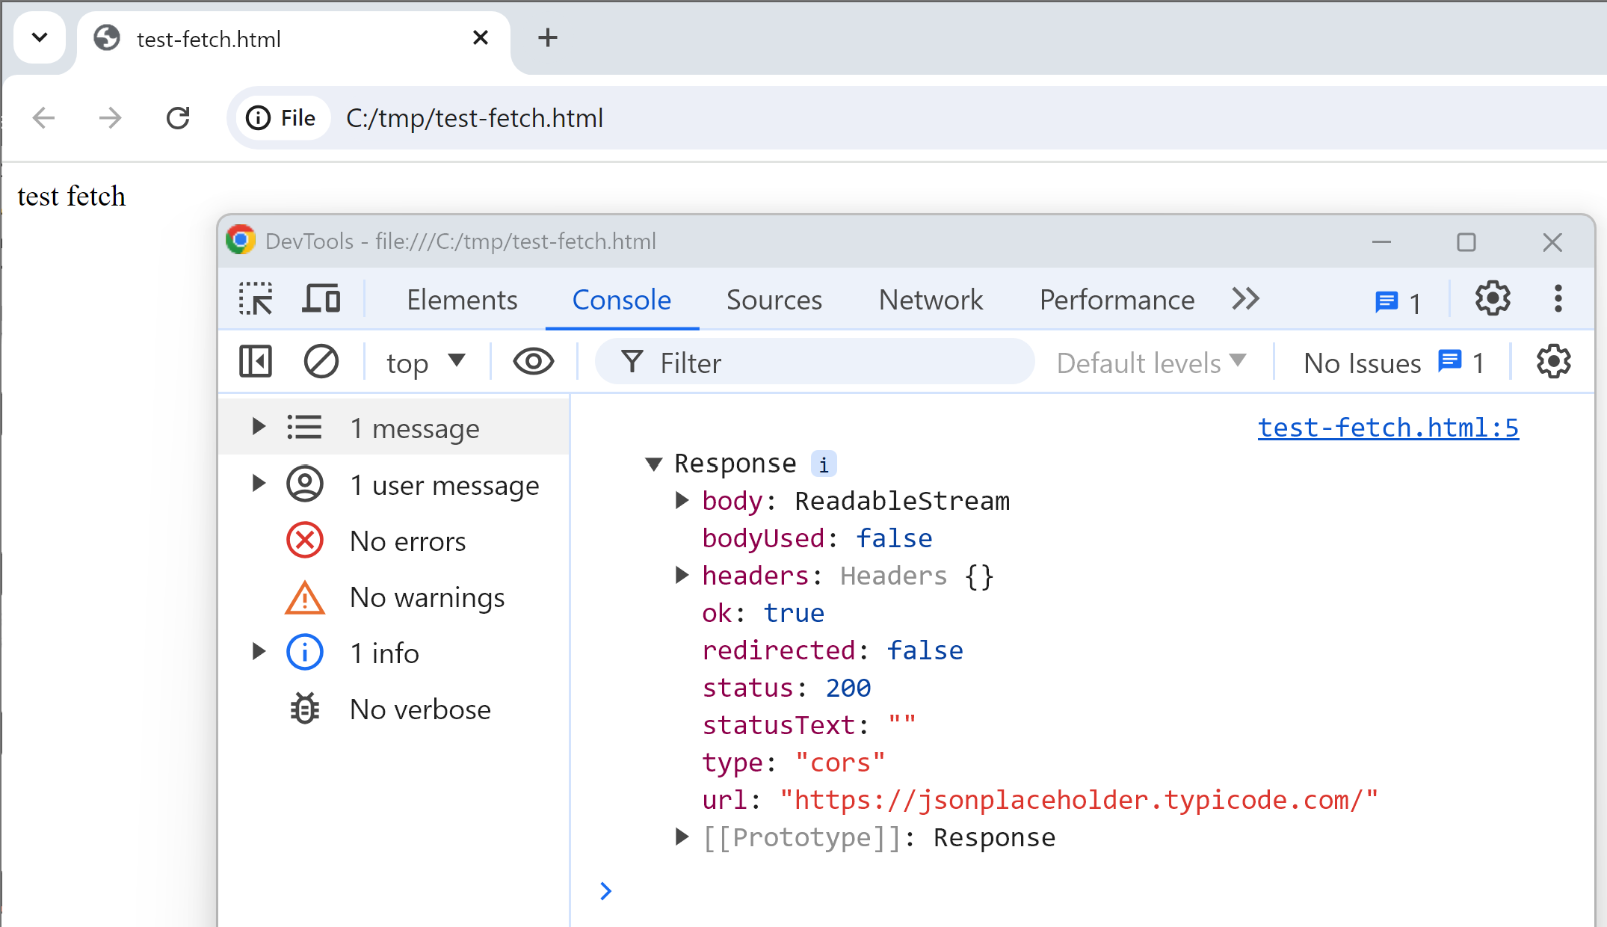
test-fetch.html
(1/3) Edit Html code, save file
(2/3) open browser
(3/3) Open DevTools (F12)
open Console

Slide 44
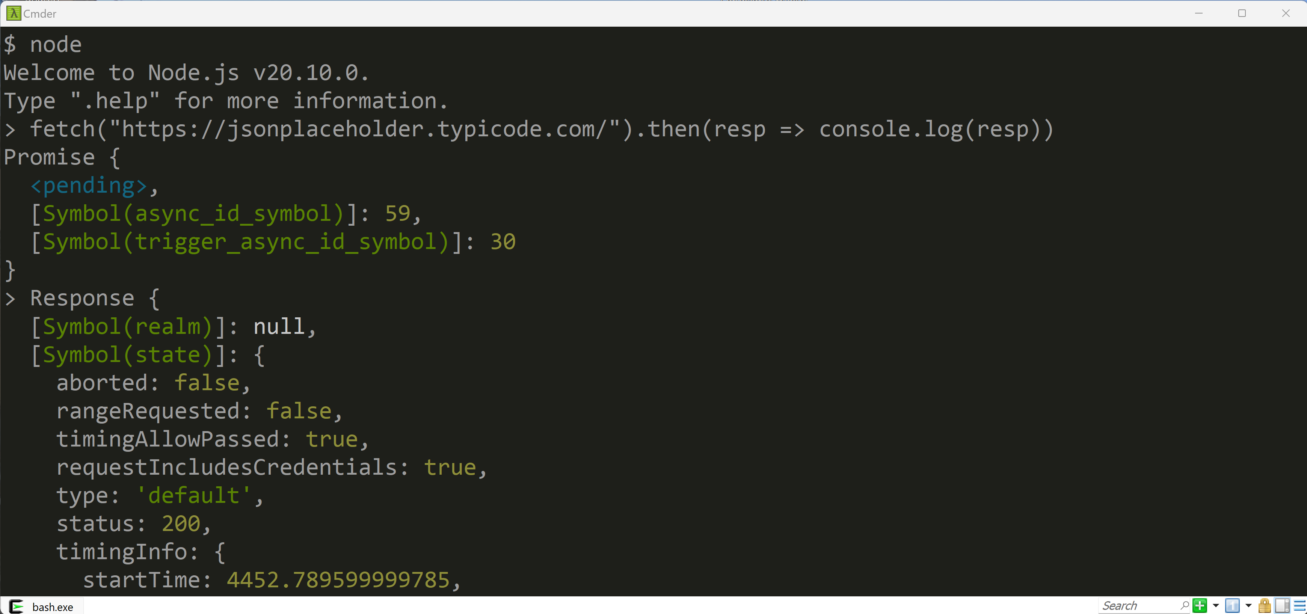
using NodeJS (same Javascript interpreter V8 as Chrome/Edge)

Slide 45
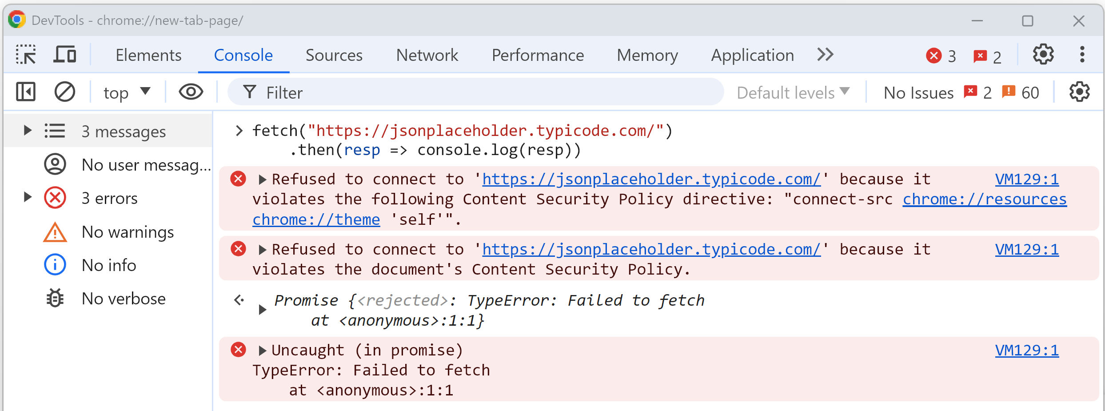
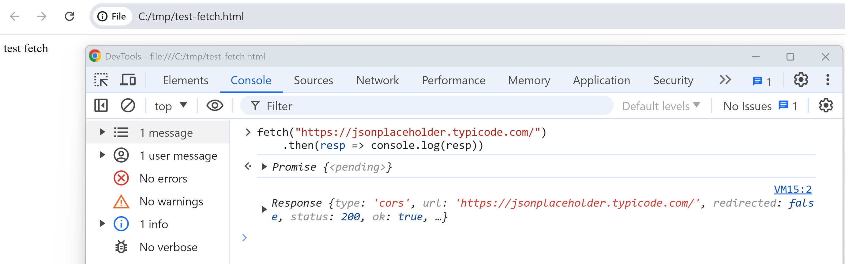
fetch() from DevTool Console... Fail "CORS"
ANNEXE
Fail "CORS" from
website
OK from file://

Slide 46
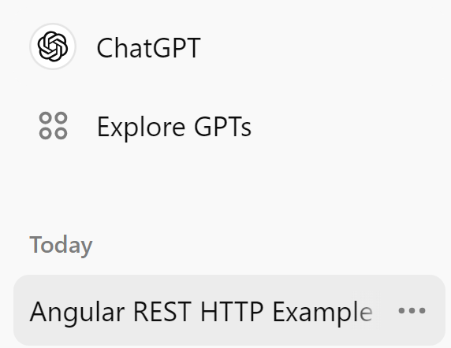
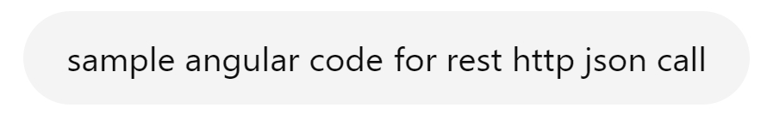
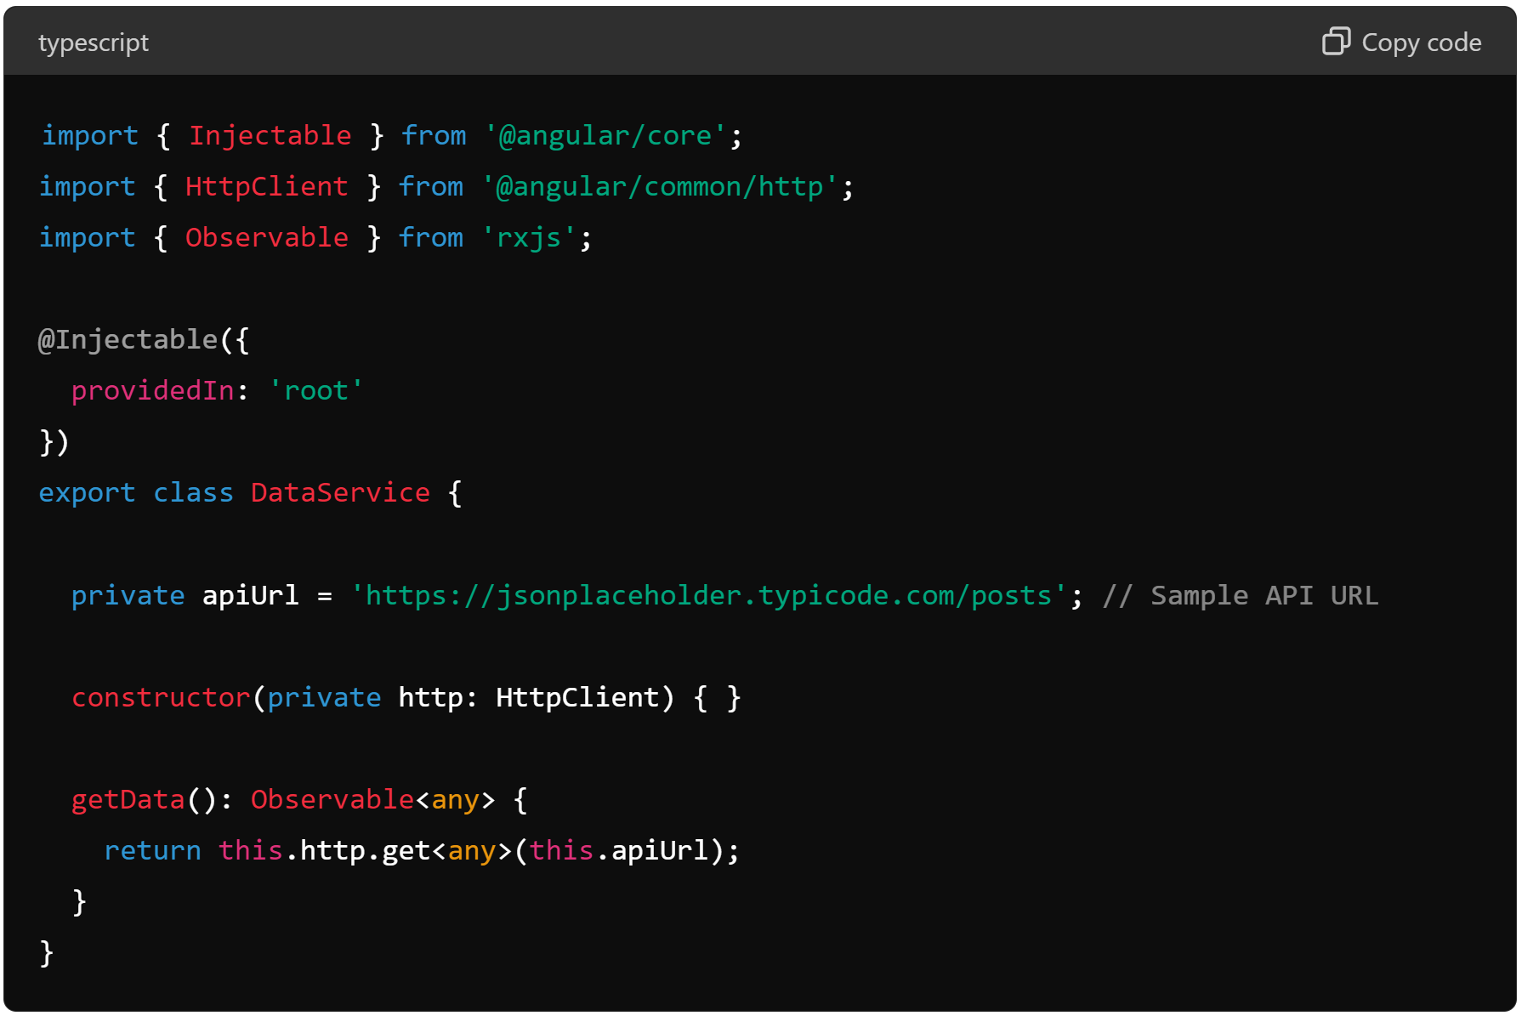
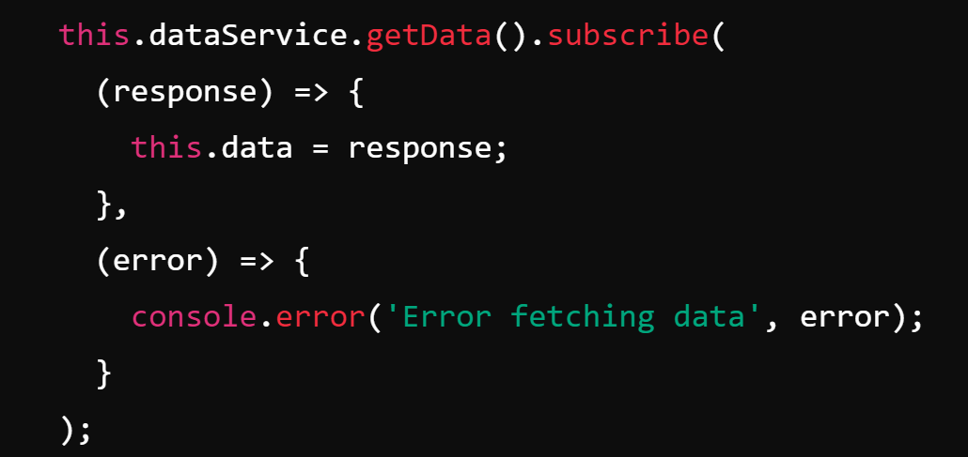
Sample Angular Code for Rest Http+Json Request

Slide 47
Easy Interactions between Javascript / Json !
JavaScript
or TypeScript
Json
(= Javascript value)
var jsonRequestBody = { json: "is data" };
this.httpClient.post("url", jsonRequestBody)
.subscribe( jsonResponseBody => {
this.jsResult = jsonResponseBody;
})
JS -> Json -> Http EASY
Http -> Json -> Js EASY

Slide 48
Summary Interaction: JavaScript call (Async) Http Rest JSON Api
Html (DOM)
Https
(1) http request
async fetch, or httpClient
prefer JSON
(2) http response, in JSON
using callbacks
=> assign result to javascript var
JavaScript

Slide 49
Outline
Https → Load Html + Js + Css + Json + *
Js → Call Http : SPA, Rest + Json
Html → execute Js <script>
Html → trigger events to Js
Js → Query/Update Html DOM
Custom Elements, Shadow DOM, Frameworks

Slide 50
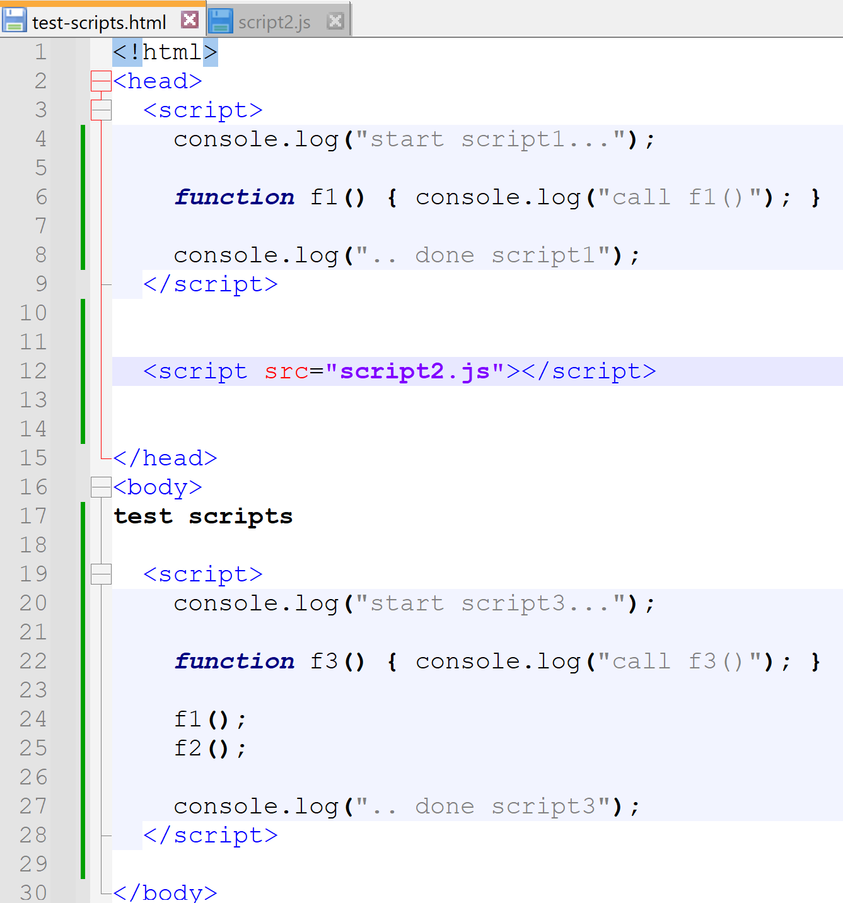
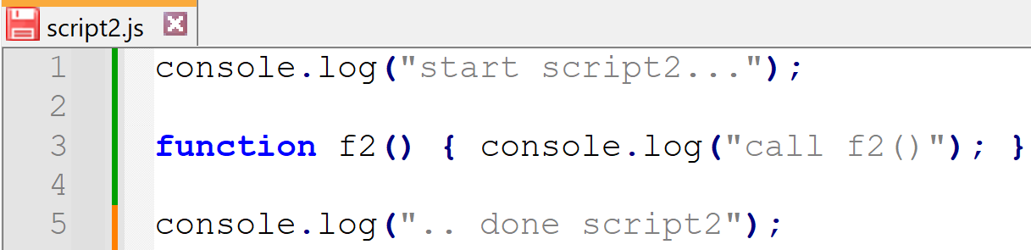
<script>..</script> & <script src=".."/>
embedded <script> in head
external <script src="..">
embedded <script> in body

Slide 51
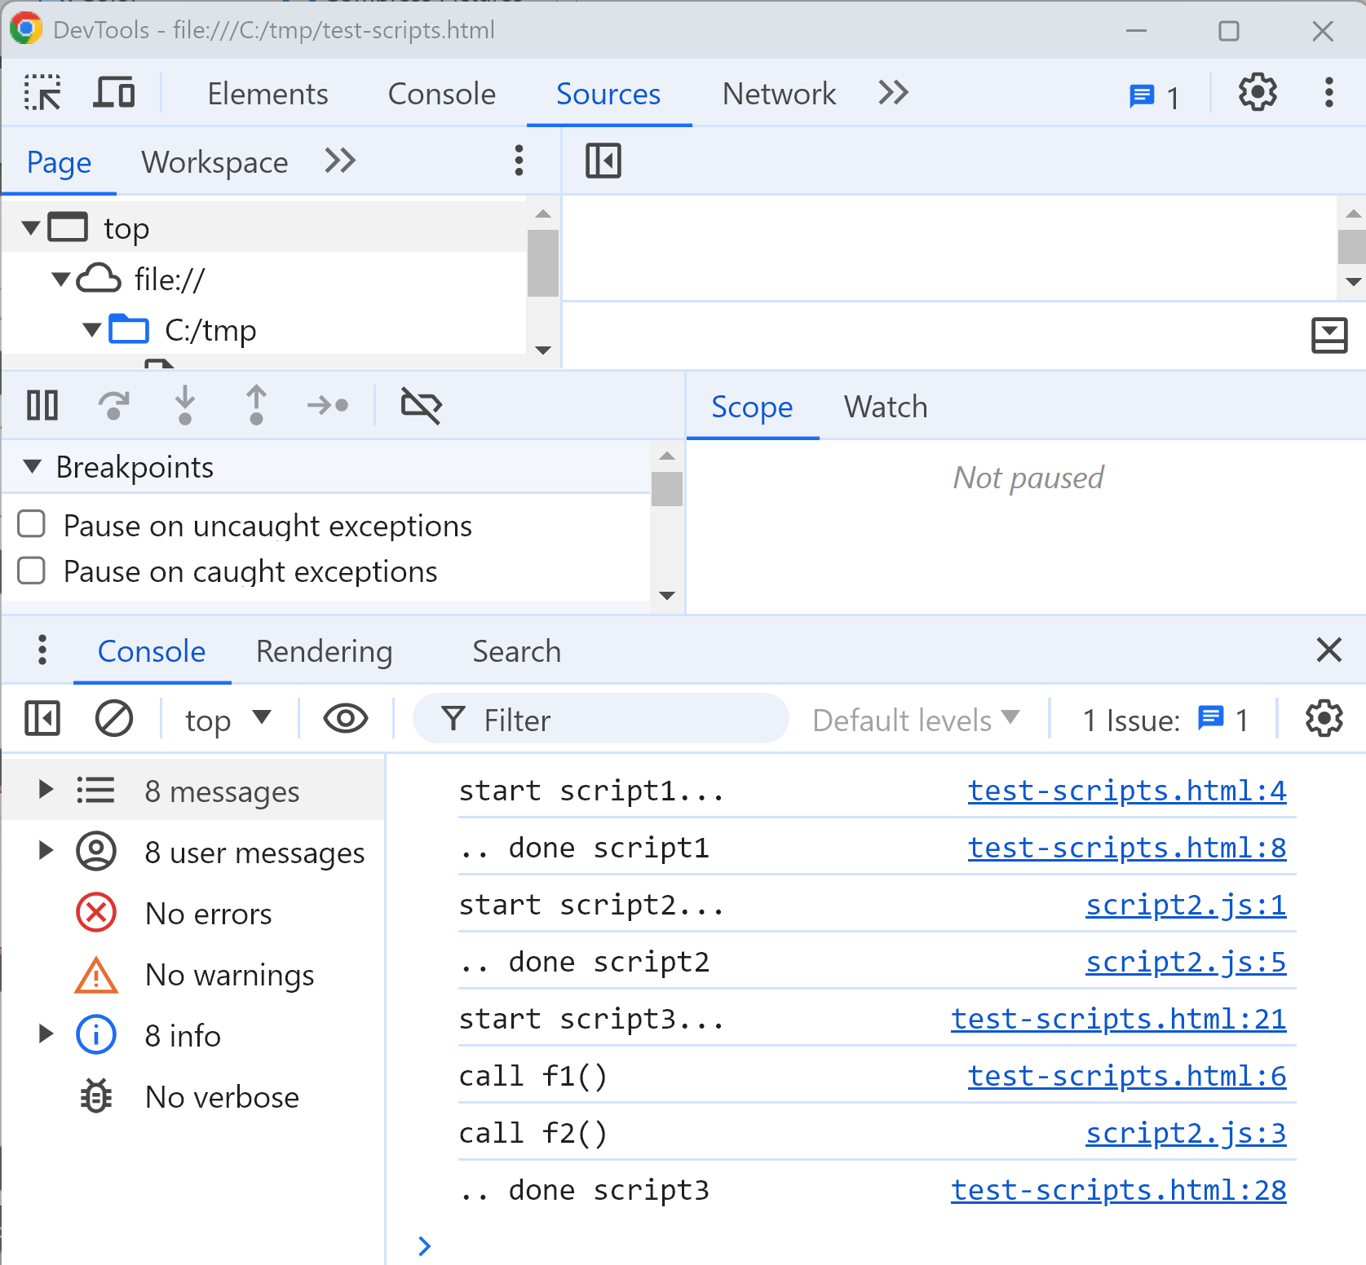
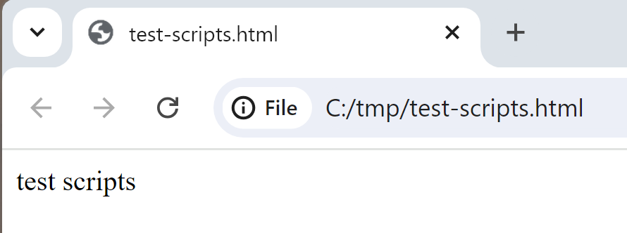
Sample <script>

Slide 52
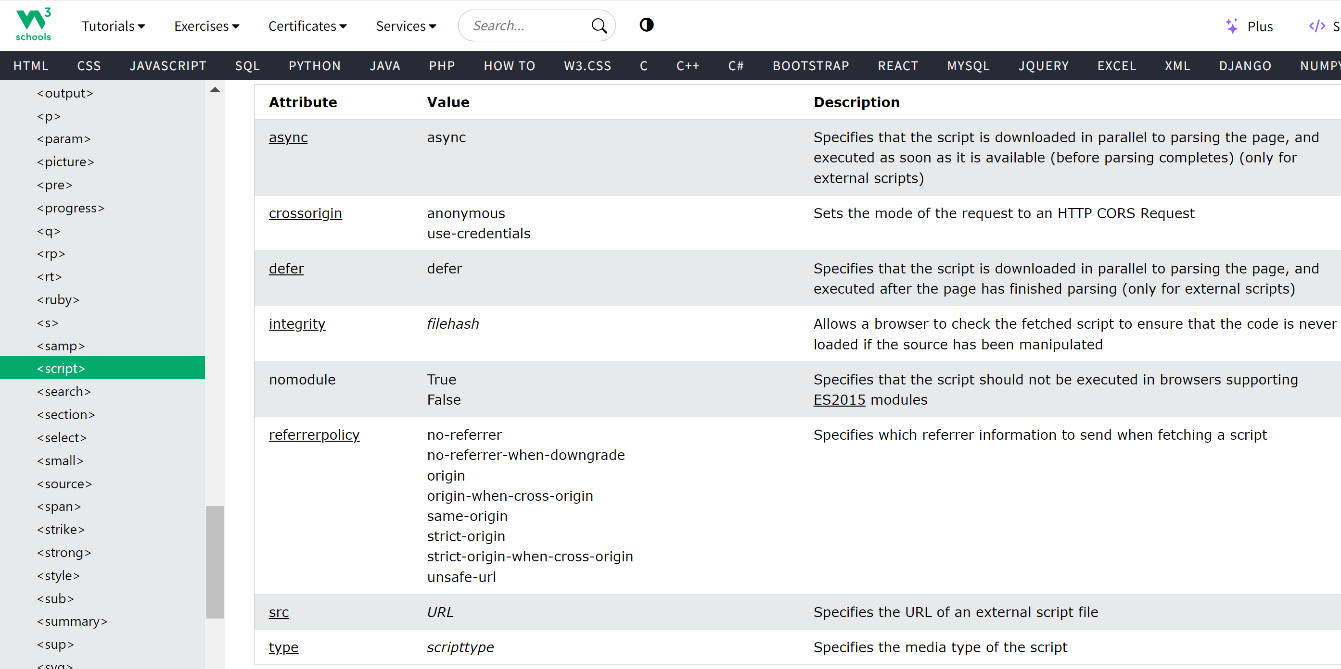
<script (async | defer) src="..">
with many <script>, load (+parse) in parallel using async
see https://www.w3schools.com/tags/tag_script.asp

Slide 53
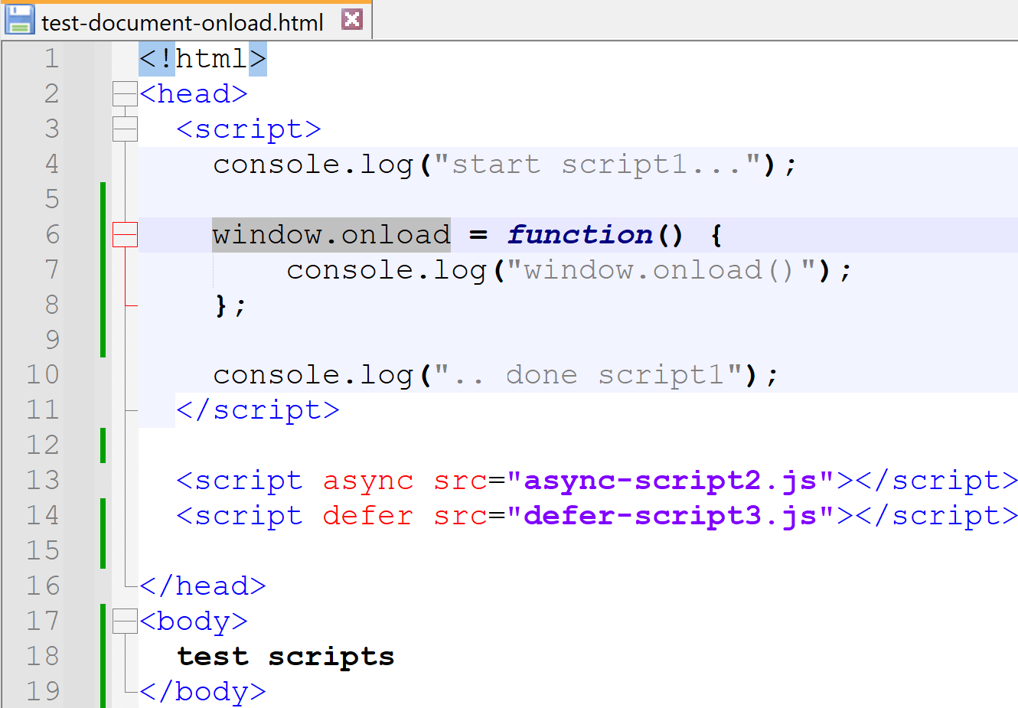
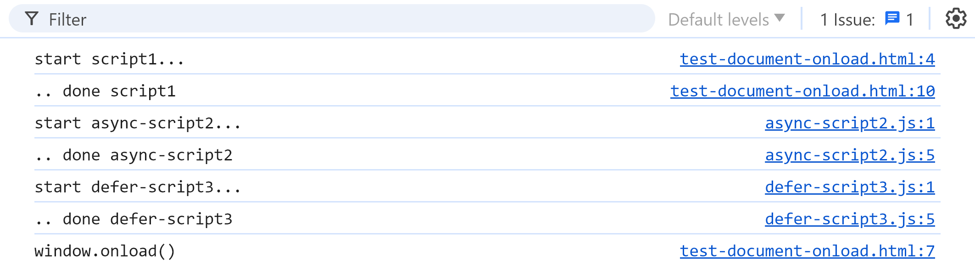
window.onload = callbackReference;

Slide 54
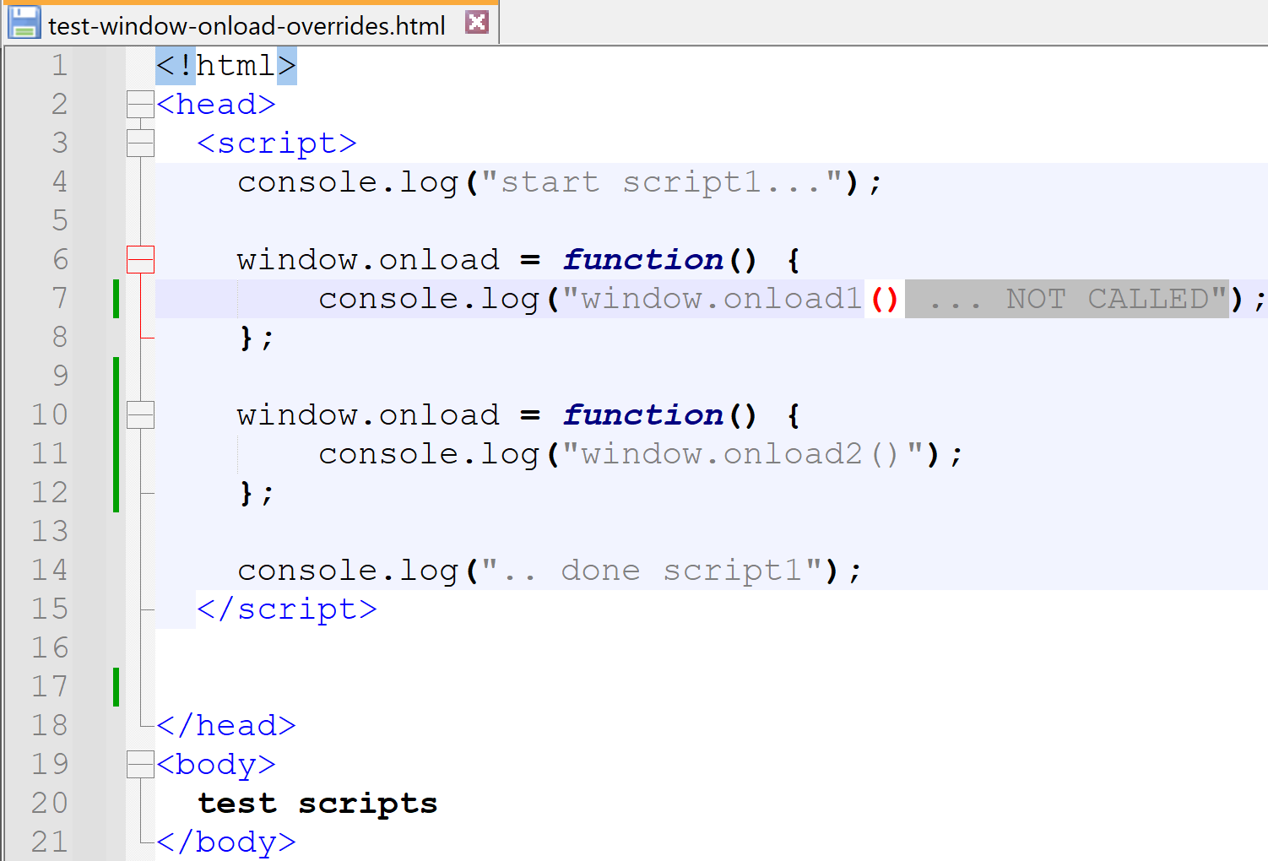
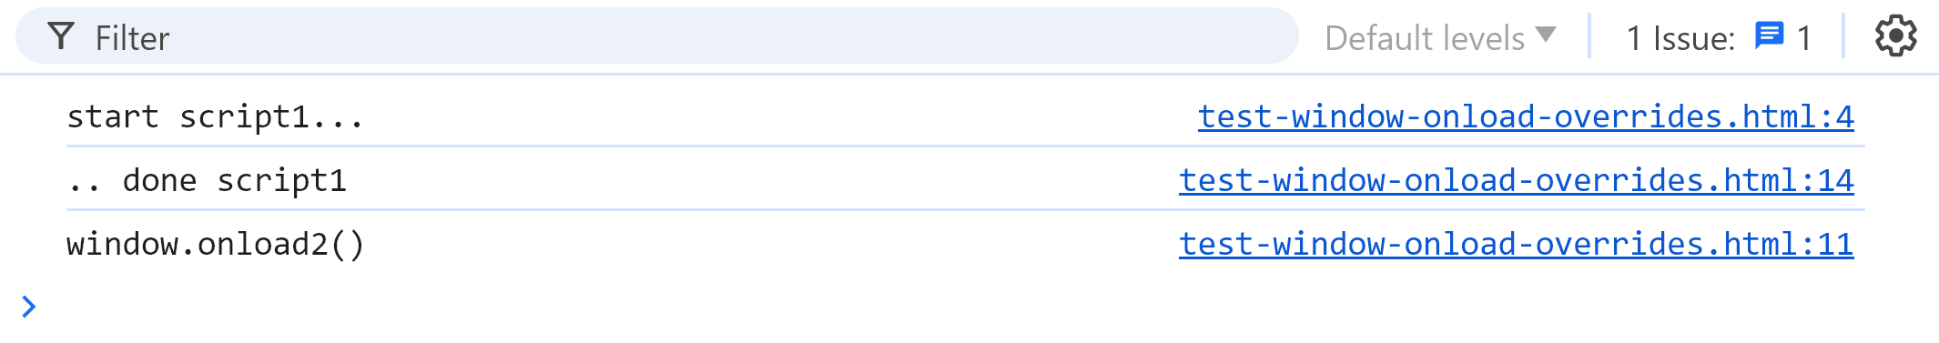
Window ... global singleton Can NOT set several ".onload" callbacks !

Slide 55
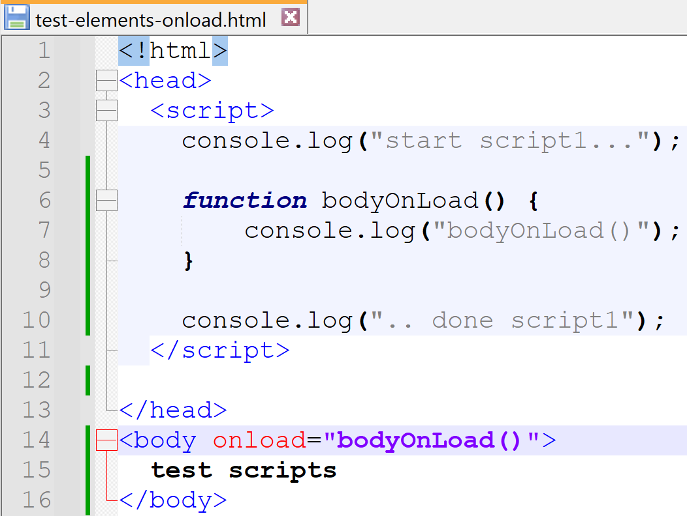
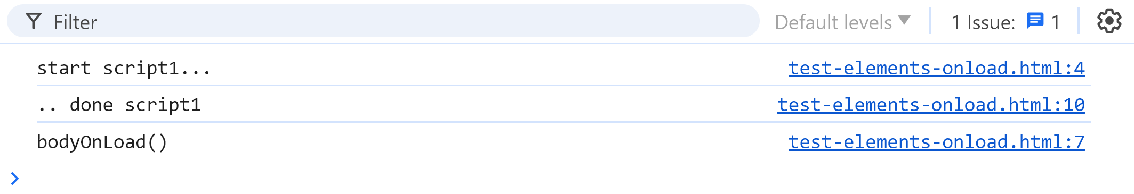
<body onload="someCode()">

Slide 56
Summary Interaction: Html execute <script>
Html (DOM)
Https
load <script>
execute callback
on window / document
JavaScript

Slide 57
Outline
Https → Load Html + Js + Css + Json + *
Js → Call Http : SPA, Rest + Json
Html → execute Js <script>
Html → trigger events to Js
Js → Query/Update Html DOM
Custom Elements, Shadow DOM, Frameworks

Slide 58
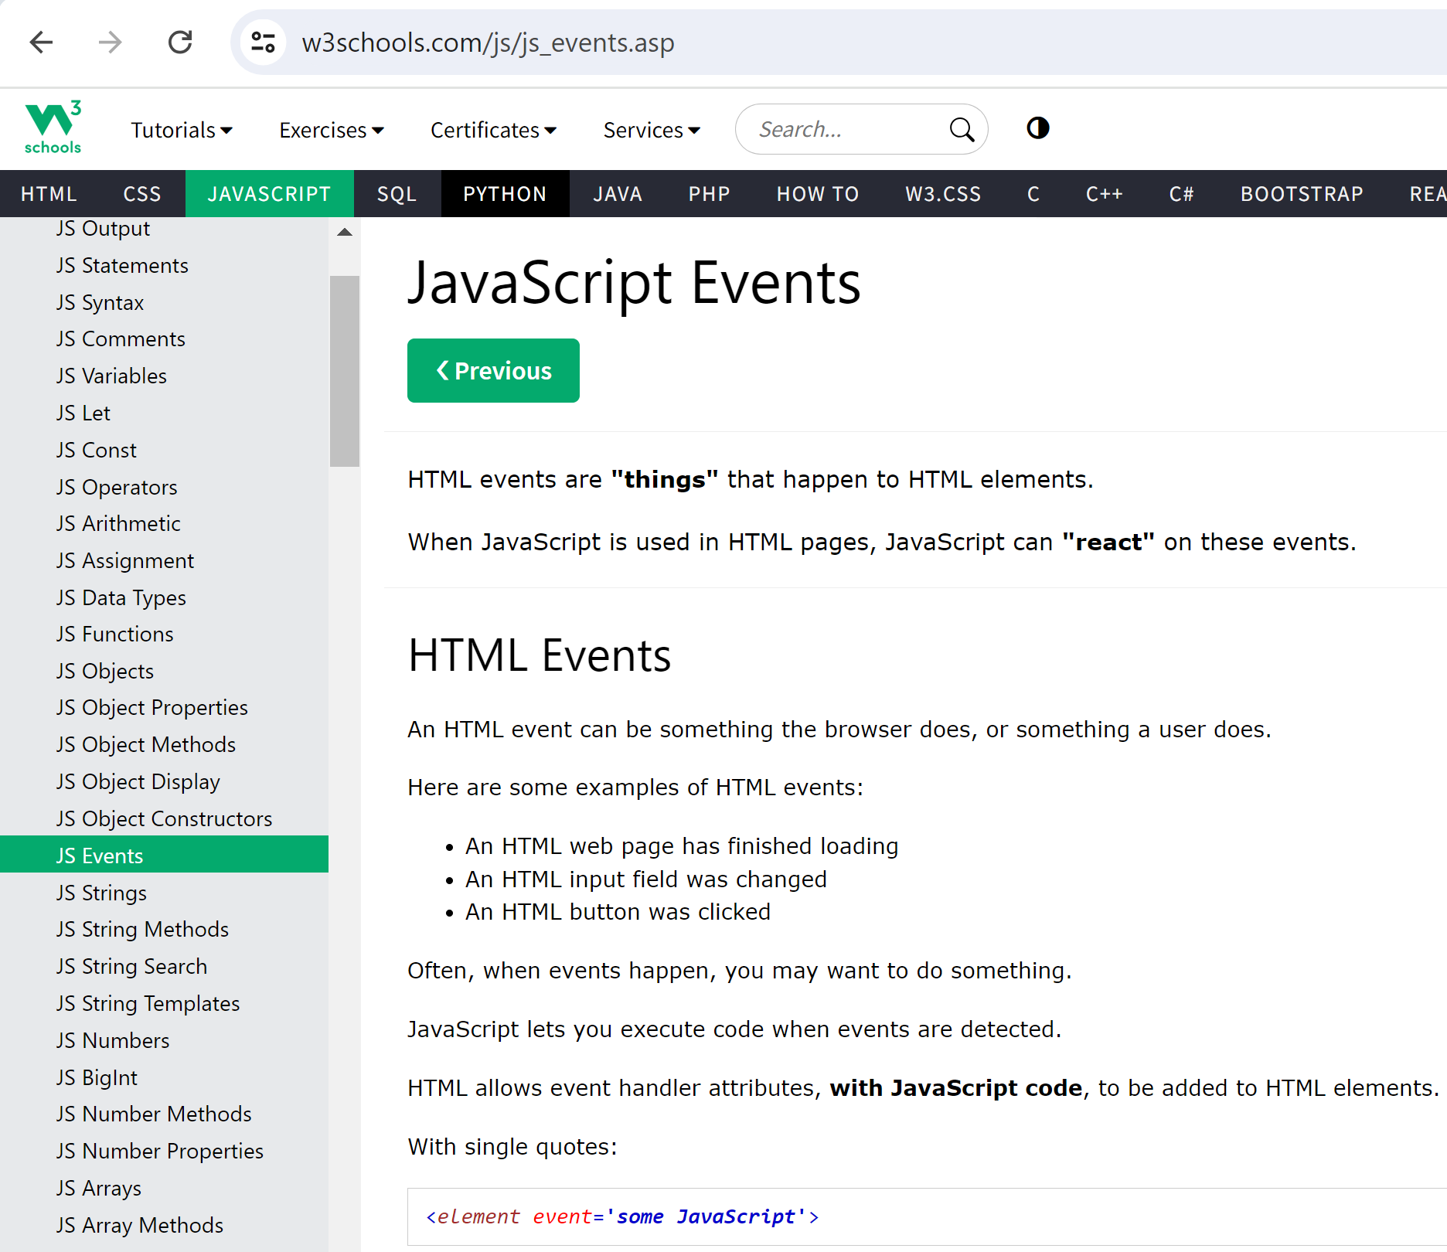
w3schools Javascript > JS Events

Slide 59
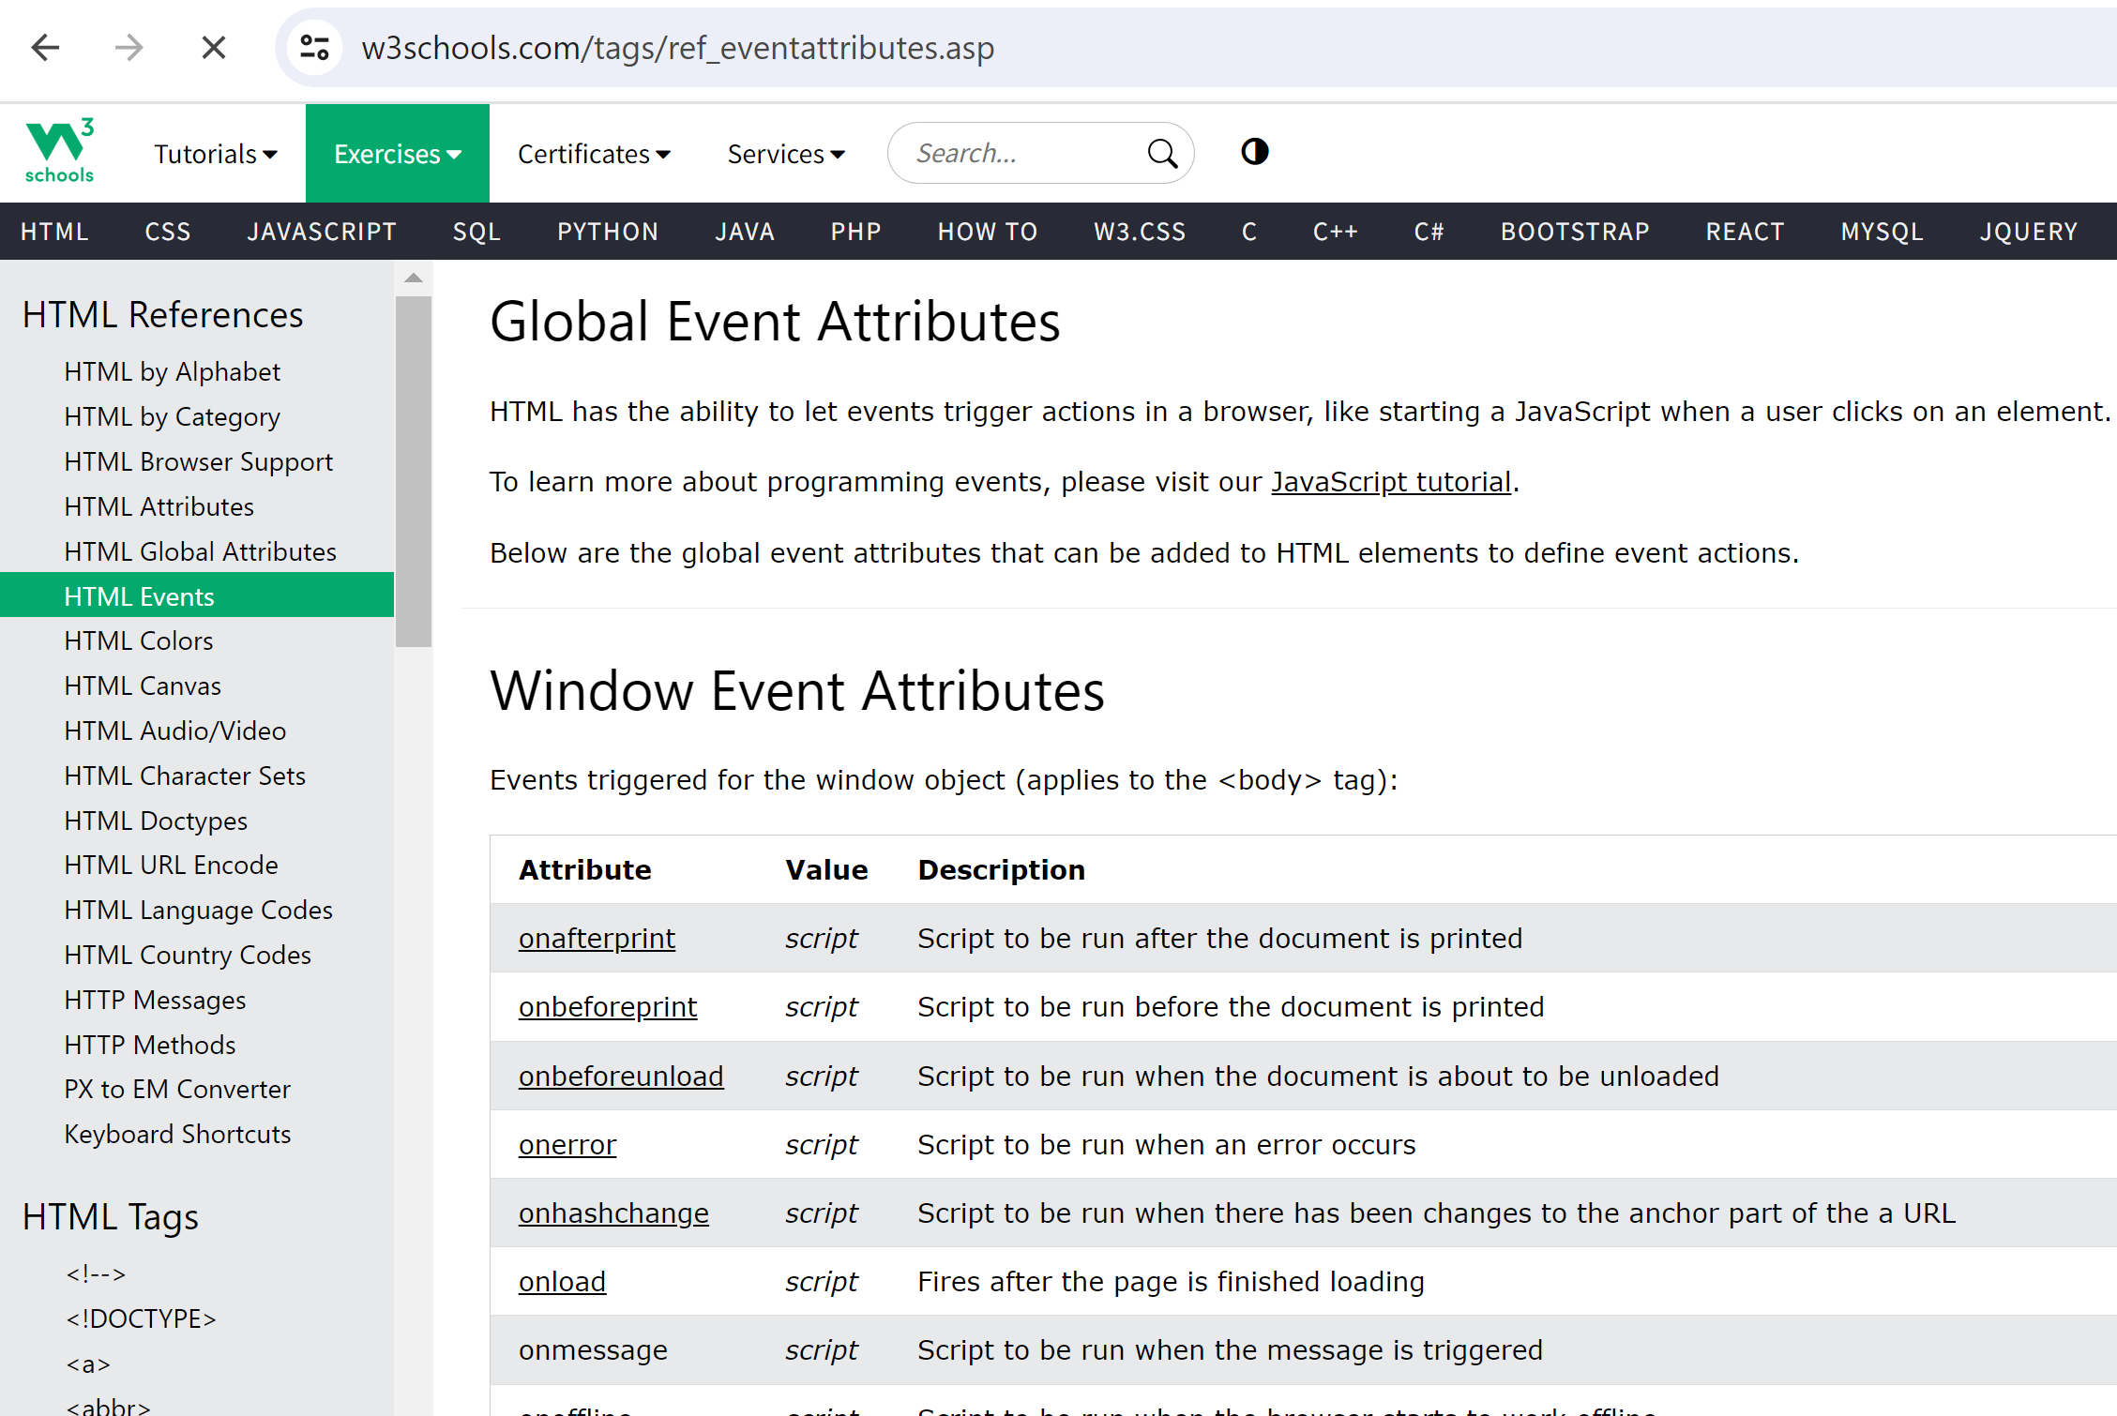
w3schools HTML Events

Slide 60

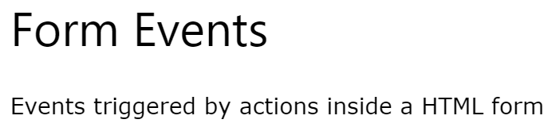
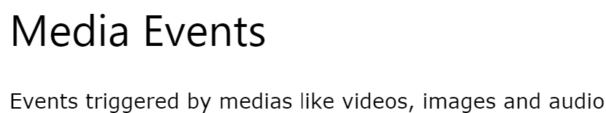
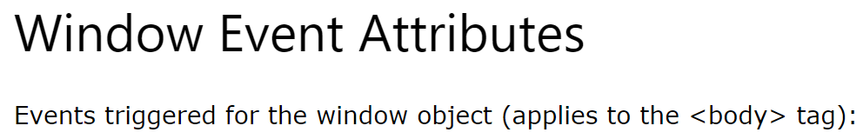
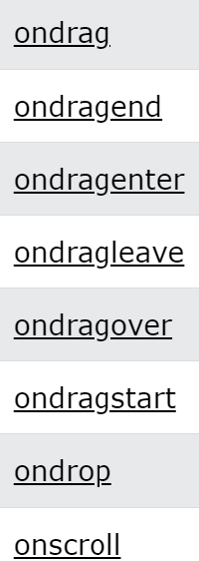
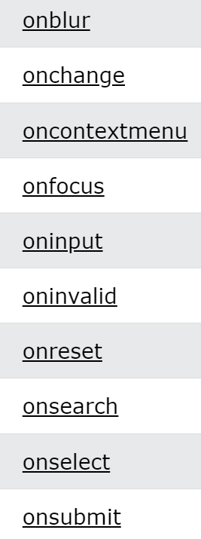
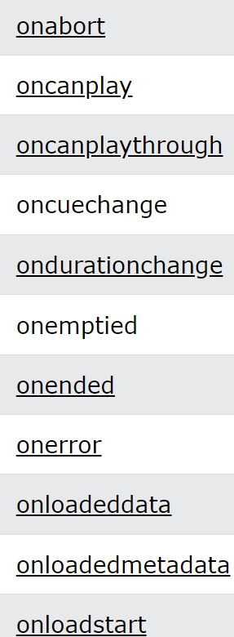
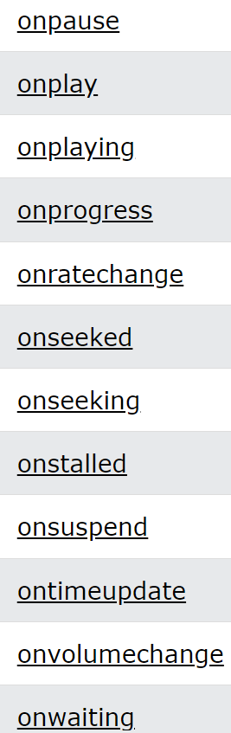







Types of Events

Slide 61

HTML "onclick" Event Attribute (attribute, with value executed as script)

Slide 62



onclick

Slide 63


onclick event

Slide 64


Event Bubbles Up ..
https://en.wikipedia.org/wiki/Event_bubbling

Slide 65

Event Bubble: Sample Code

Slide 66

Event Bubble: Sample Execution

Slide 67

Stopping Propagation: Sample Code

Slide 68

Stopping Propagation: Sample Execution

Slide 69

Script vs Function Callback ?
What do we get ?
3 different scripts
- function with event
- no event
- script code

Slide 70

Scripts are "compiled"/"wrapped " similary in Function with 1 event param

Slide 71



Set in Code: with Function (not String)

Slide 72



Set in Code ... Silent error with String !!
NOTHING Happen when click (not even error)
setting attribute was silently ignored

Slide 73

In Angular: (click)="script..."
instead of native JavaScript :
onclick=<<Window script (event)>>
=> in Angular :
(click)=<<Component script ($event)>>
script binded to the component context
$event instead of event
No Bubbling of event

Slide 74
Outline
Https → Load Html + Js + Css + Json + *
Js → Call Http : SPA, Rest + Json
Html → execute Js <script>
Html → trigger events to Js
Js → Query/Update Html DOM
Custom Elements, Shadow DOM, Frameworks

Slide 75
D.O.M. ?
Document
Object
Model
= API to handle HTML Document in JavaScript

Slide 76



HTML Source <-> Tree of Elements
Rendering:
may add border to see container/content
DevTool Inspect:
can shrink/expand any element
well formatted xml: <element> .. </element >

Slide 77
DOM Tree
Window
Document
Head
text="div1-text"
Body
Text
text="div2-text"
DivElement
Text
text="div3-text"
id="div1"
DivElement
Text
id="div2"
(1) parent relation
child relations
DivElement
id="div3"

Slide 78


DOM Tree: navigable per ".getElementById", ".parentElement" ".children"

Slide 79
parentNode <-> parentElement childNodes <-> children
HTML contains also "Node"
"text"
<!-- comment -->
<![CDATA[ ... ]]>
..
Element is abstract sub-class of Node.
<h1>, <p>, <div>, <span>, <...> are all Elements.
HTML DOM Tree can be navigate by Node
(more general then Element)

Slide 80
HTML DOM Classes => TS interface pseudo-declaration
interface Node {
parentNode;
childNodes;
// parentElement, children .. computed from parent|child Node
}
interface Text extends Node {
text: string;
}
interface Element extends Node {
readonly tagName: string;
attributes: Map<string,string>;
}
interface Div extends Element {
readonly tagName= "div";
}
...

Slide 81
HTML DOM Interfaces => UML Class Diagram
Node
Document
Element
Attribute
Text
Comment
CData
Head
Body
H1
Div
Span
Button

Slide 82

HTML DOM Api Reference https://developer.mozilla.org/en-US/docs/Web/API/HTML_DOM_API

Slide 83

w3schools ... DOM Classes List: page 1/3

Slide 84

DOM Classes List: page 2/3

Slide 85

DOM Classes List: page 3/3

Slide 86

Focus on class "Button" (page 1/2)
to get an existing <button id="..">
to create a "new Button()" ??
document.createElement("button")

Slide 87

class "Button" (page 2/2)

Slide 88

Reference HTMLButtonElement interface

Slide 89


API to Add/Replace/Remove Dom Node

Slide 90


Sample Code to Add/Remove HTML

Slide 91

Debugging Elements (in-memory differ from Sources, refresh by "F5")

Slide 92
Outline
Https → Load Html + Js + Css + Json + *
Js → Call Http : SPA, Rest + Json
Html → execute Js <script>
Html → trigger events to Js
Js → Query/Update Html DOM
Custom Elements, Shadow DOM, Frameworks

Slide 93

Code Maintainability of <div> soup ?

Slide 94

HTML Custom Elements

Slide 95

Reference Custom Elements
https://developer.mozilla.org/en-US/docs/Web/API/Web_components/Using_custom_elements

Slide 96

Custom Element Sample (Feature 1/4) Window.customElements.define("new-tag"...)

Slide 97

DOM Tree ... <popup-info>

Slide 98


Not calling ".define()" ... same DOM anyway!?

Slide 99



Custom Element (Feature 2/4) Shadow DOM - encapsulate internal elements, with style and DOM isolation

Slide 100

Navigable HTML Structure <--differs from --> Styled, Internal Shadow DOM

Slide 101


Custom Element Sample (Feature 3/4) using HTML Template

Slide 102

result of HTML Template

Slide 103

Custom Element (Feature 4/4) using Lifecycle callbacks & properties

Slide 104

Lifecycle callbacks

Slide 105


Sample attributeChangedCallback() + getAttribute() + Shadow DOM update

Slide 106

attributeChangedCallback=> update Shadow DOM

Slide 107


.. not broadly used ?

Slide 108

(Which - HowLong) Web Frameworks?
https://github.com/mraible/history-of-web-frameworks-timeline

Slide 109



Frameworks trends as of 2024
https://angular.dev/
https://react.dev/
https://vuejs.org/

Slide 110

Angular 18 (may 2024) very different/superior to Angular 17 >> to Angular 16,15, .. 2 >> completely different from Angular"JS" 1

Slide 111
React : only rendering TSX ... Need many additional libraries, for Router + State Management + Http + Async + ...
example for State Management:
- Redux (The Infamous)
- Mobx
- React Context API
- Zustand
- Recoil
- etc

Slide 112
Angular vs React
"All in one" Framework
using Typescript for code
html templating with 2-way Bindings
previously with "*ng" directives
(example *ngIf="" now replaced with "@if{ }" )
very powerfull and consistent
using RxJs for async,
and now "signals"
... long & complex to learn
pre-requisite: Typescript + RxJs
a minimalist "rendering only" Framework
with Virtual DOM (to compensate very old browser bugs)
TSX = mix of Html + Typescript interleaved
+ escaping symbols
NO binding (or only 1-way, to update yourself)
all complex features need to be added anyway
in additional libraries.
Redux -the legacy "state managment"- is very complex and now replaced
... react de facto minimalist standard,
but too many long & complex libraries to choose and learn

